Slide 1
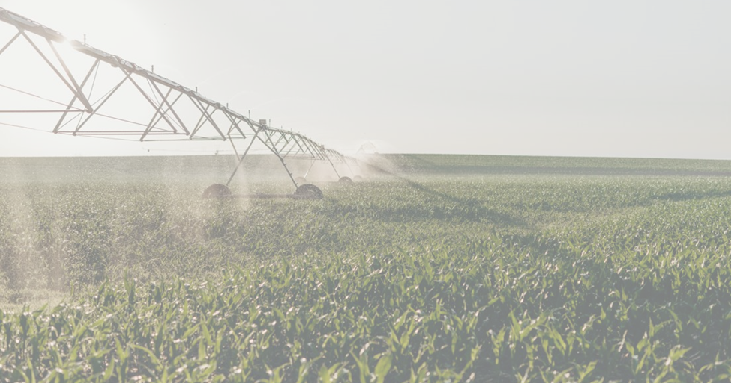
A Website for Nebraska Producers, brought to you by the Nebraska Strategic Ag Coalition Alexa Davis, Department of Natural Resources

Slide 2
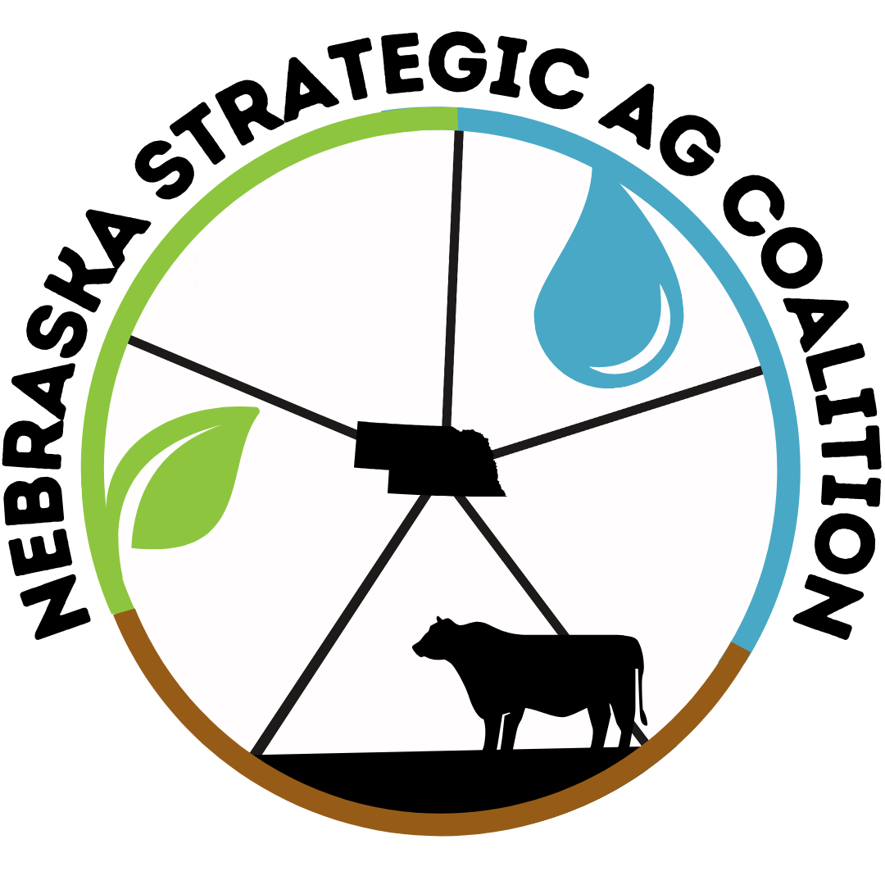
Roadmap___________________
Who is the Nebraska Strategic Ag Coalition (NSAC)?
The Needs/ Challenges That Brought Us Together
Our Flagship Program – A Website for Nebraska's Producers
Progress To Date & Strategies for Stakeholder Engagement
Tangential Developments & The Value of Collaboration
Future Vision and Aspirations

Slide 3



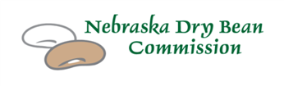



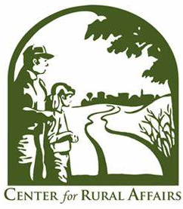
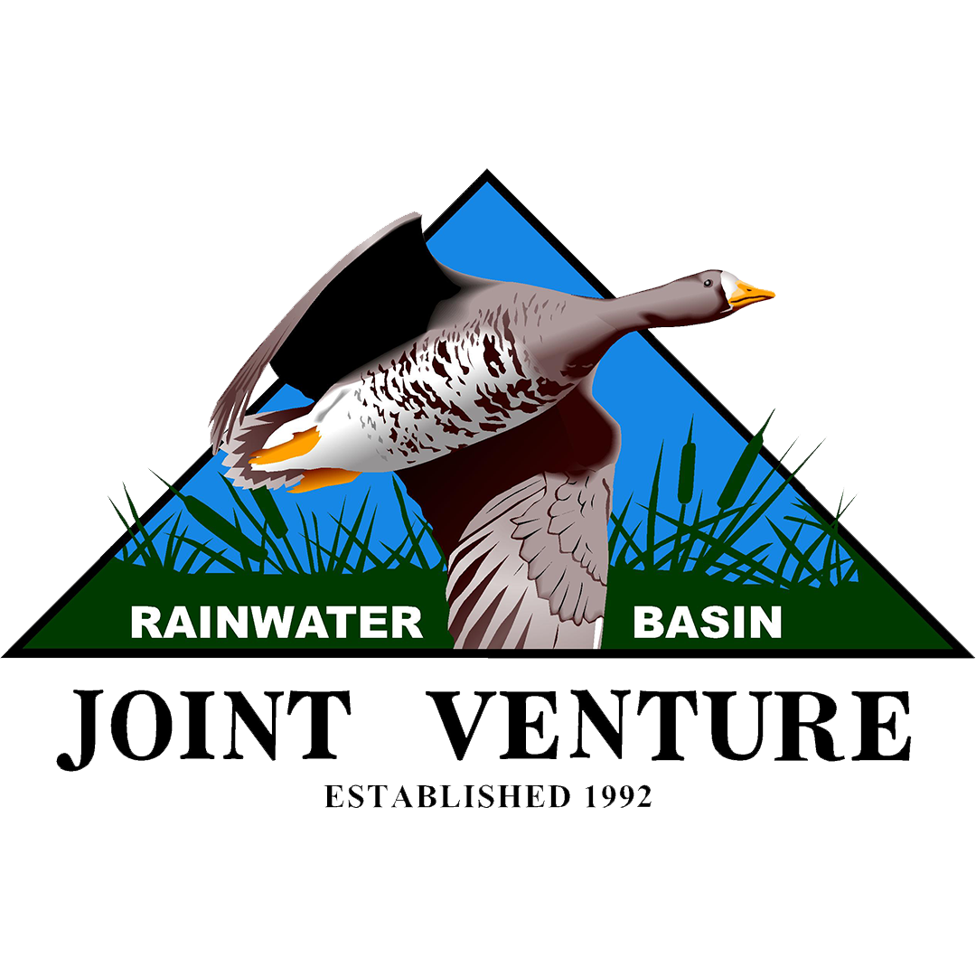







Slide 4
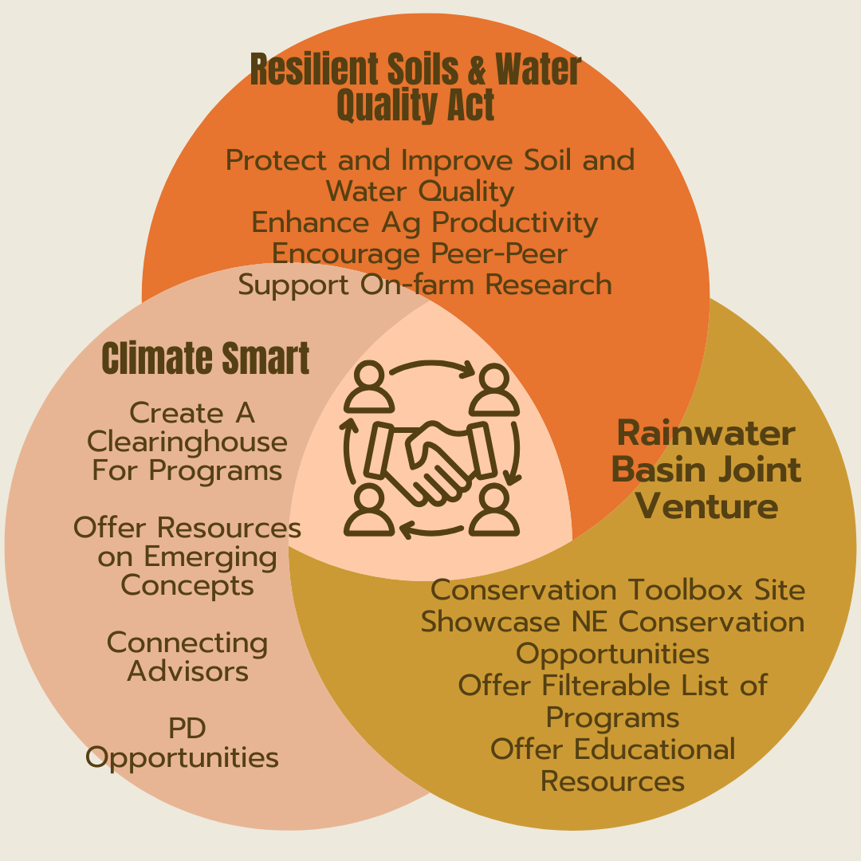
A Union Of Overlapping Efforts

Slide 5
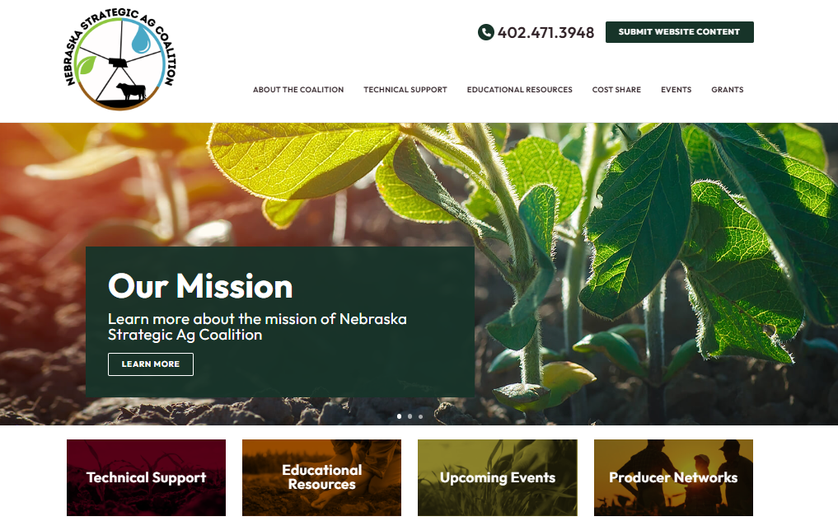
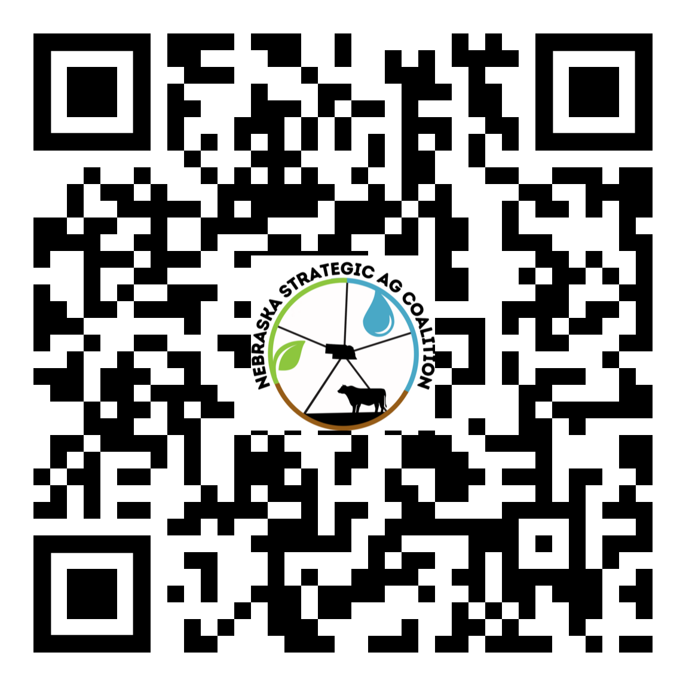

Slide 6
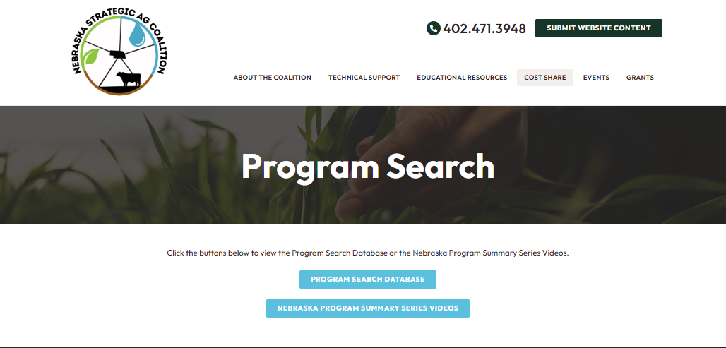

Slide 7
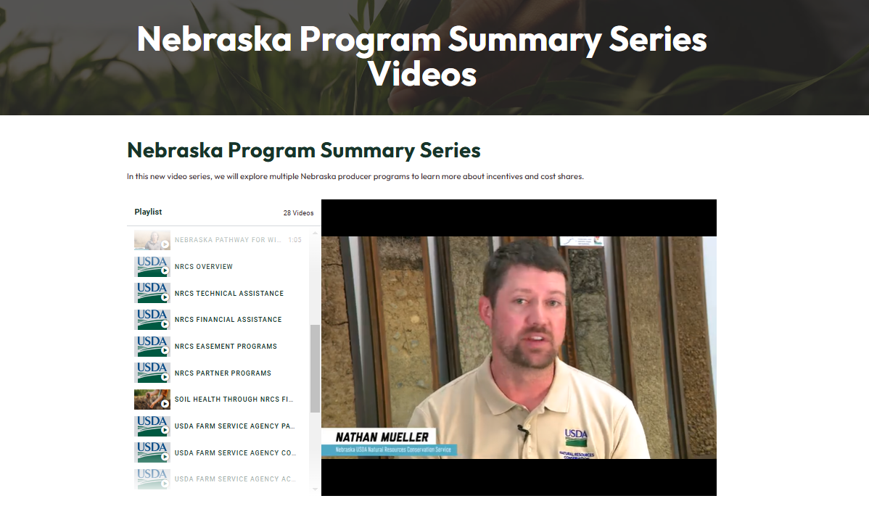

Slide 9
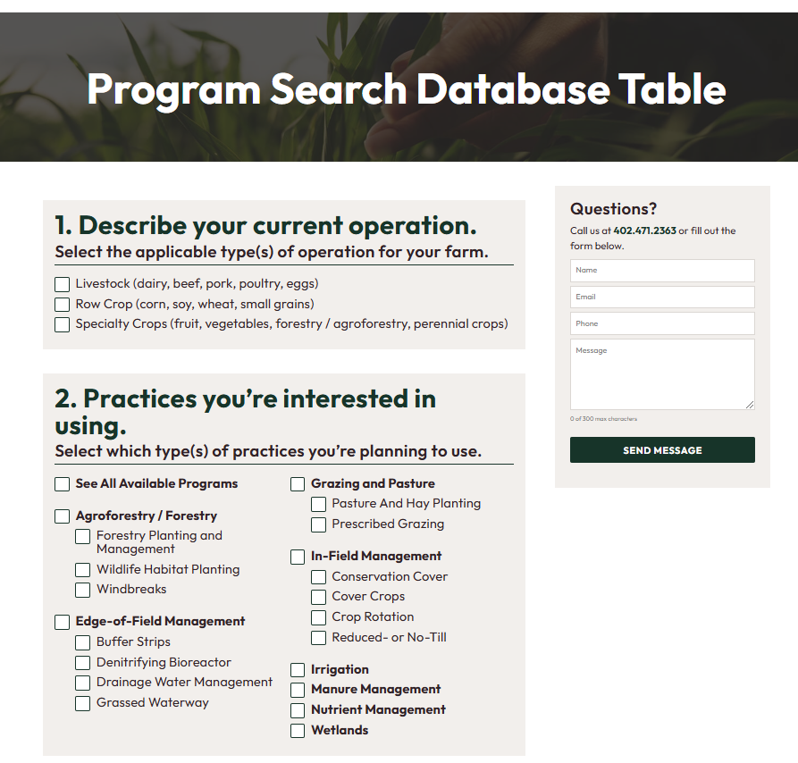

Slide 10
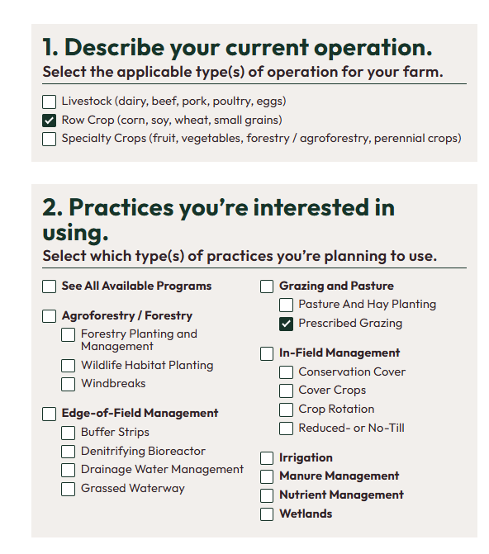
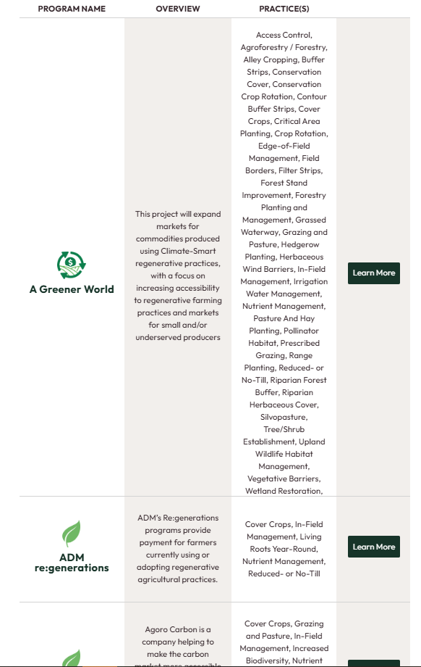

Slide 11
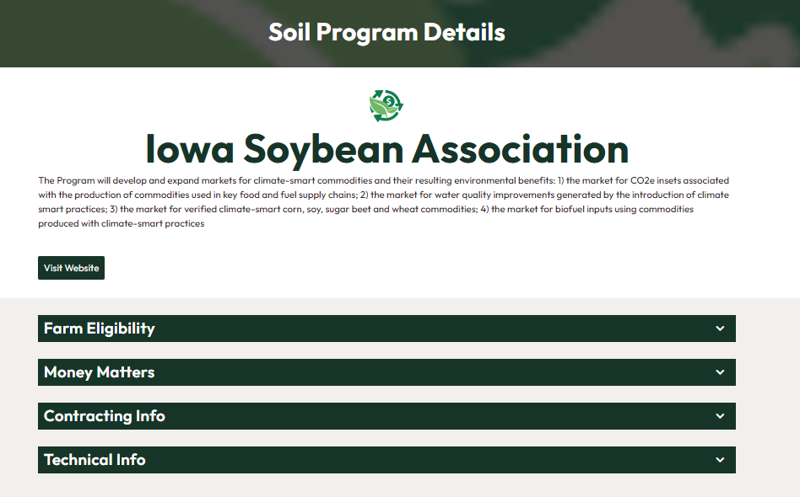

Slide 12
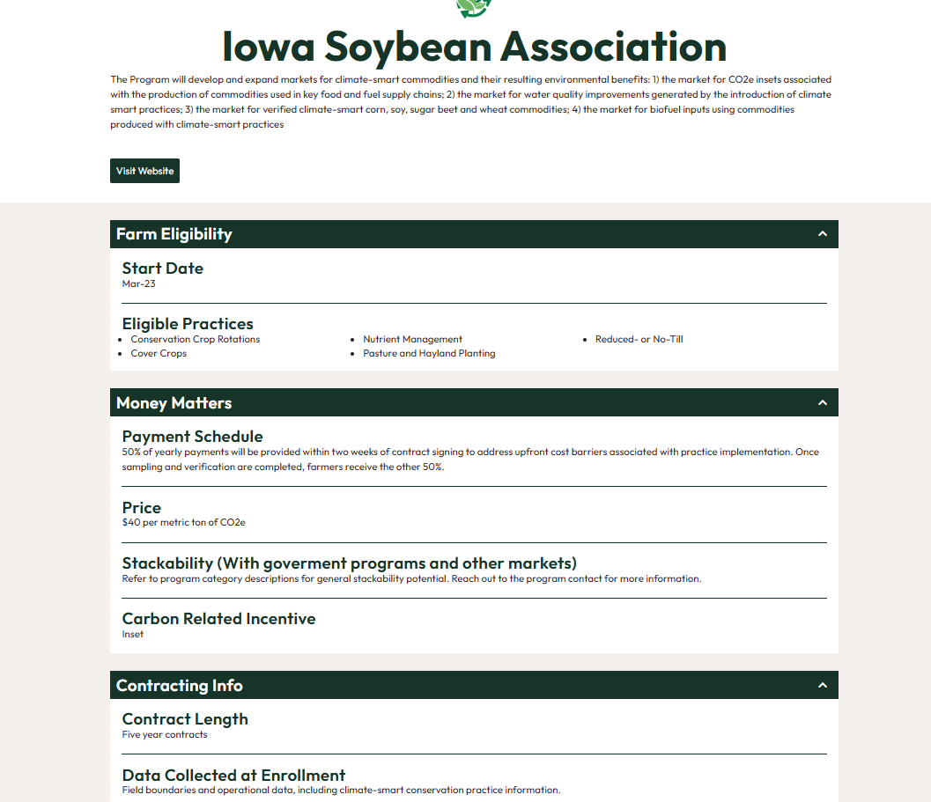

Slide 13
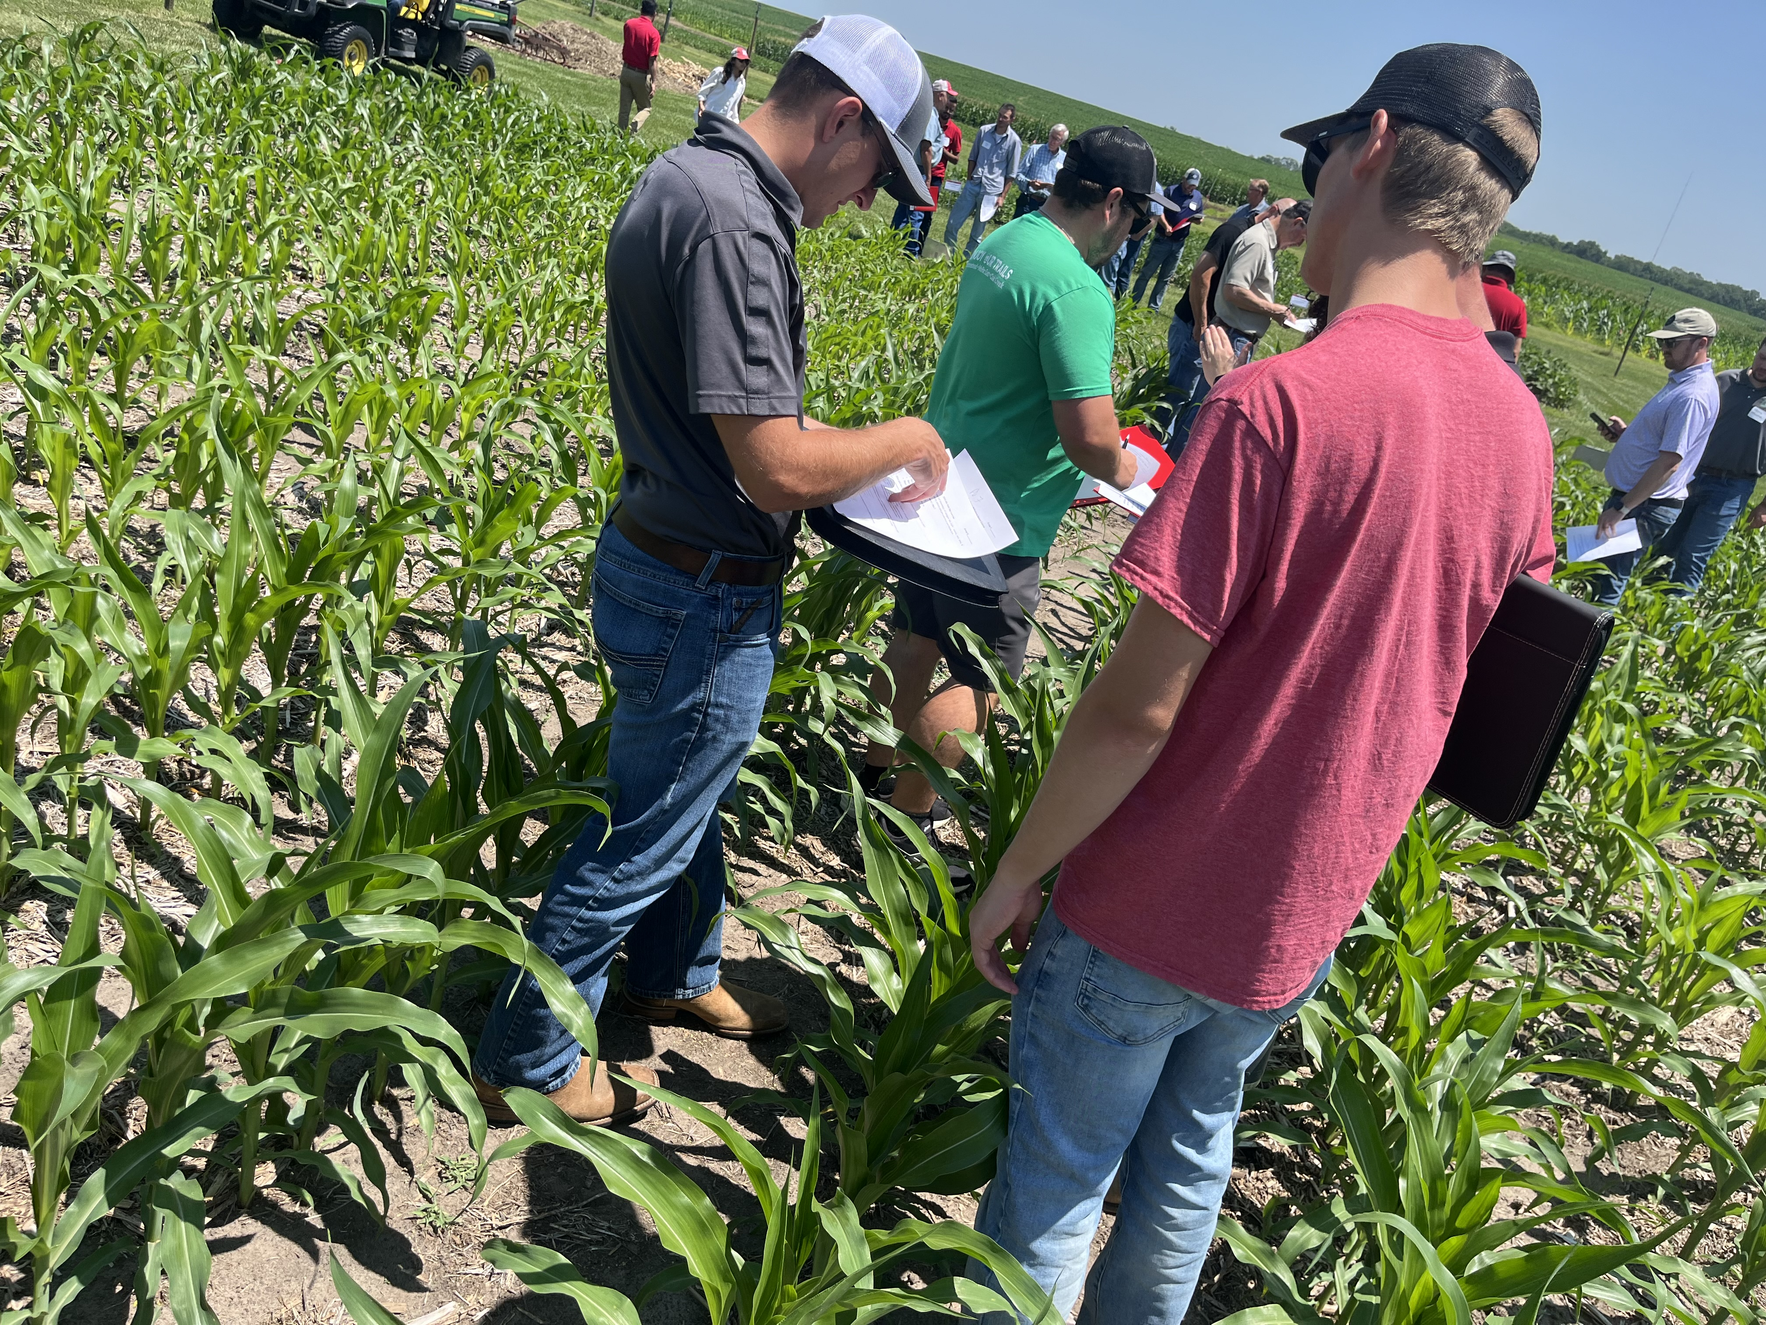
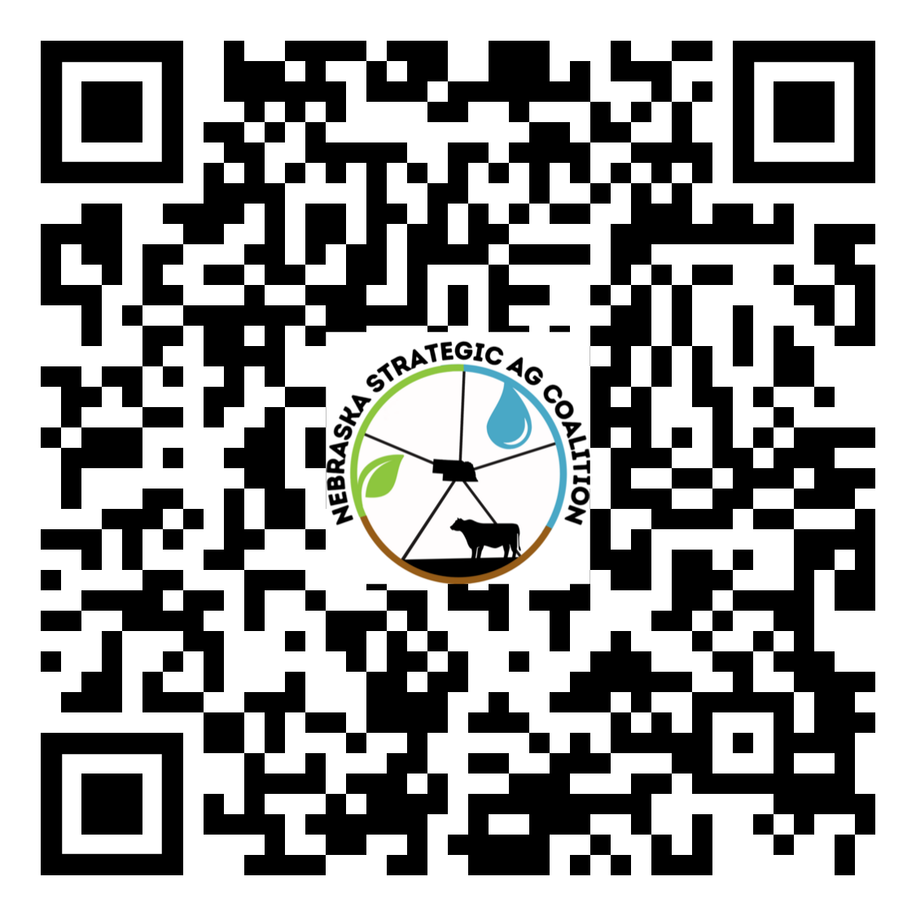
Submit Program Content!

Slide 14
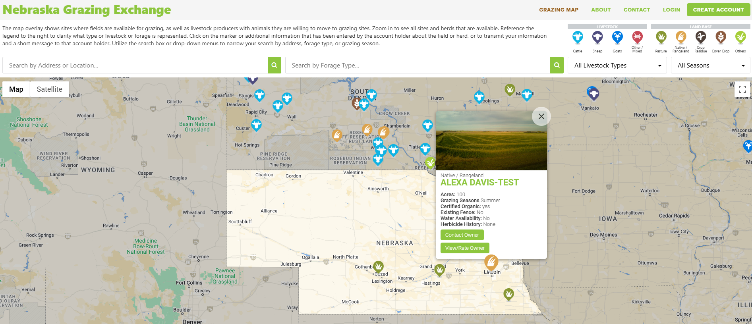
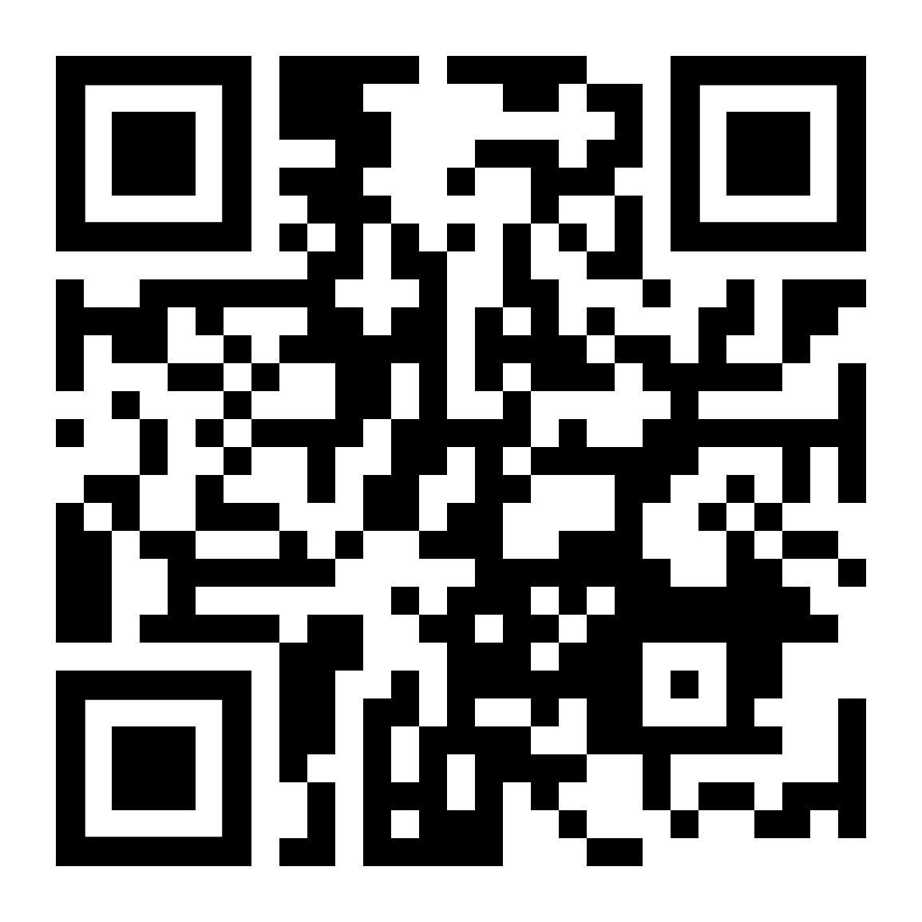
Nebraska Grazing Exchange
Nebraskagrazingexchange.com
Connecting livestock producers and those with available cropland or forage to graze by utilizing a FREE interactive map!
Integrating livestock onto cropland and proper grassland management are key steps in increasing overall soil health and productivity.

Slide 15
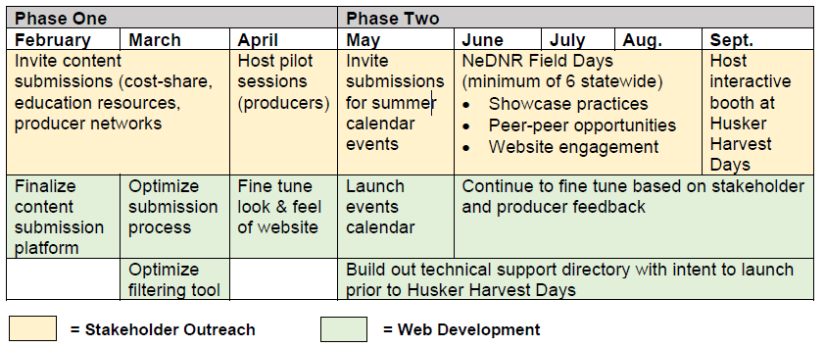

Slide 16
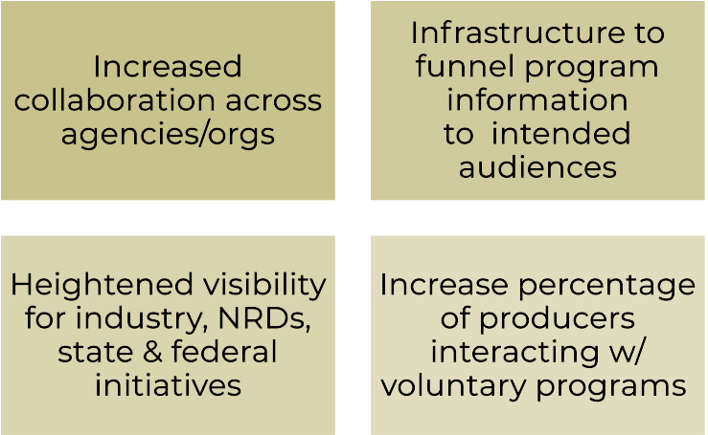
The Value NSAC Brings
Website Development
Allowing producers to easily compare options
Digital library for agronomy and conservation staff
Coalition Development & Interaction
A clearer picture of statewide program
reach & involvement

Slide 17
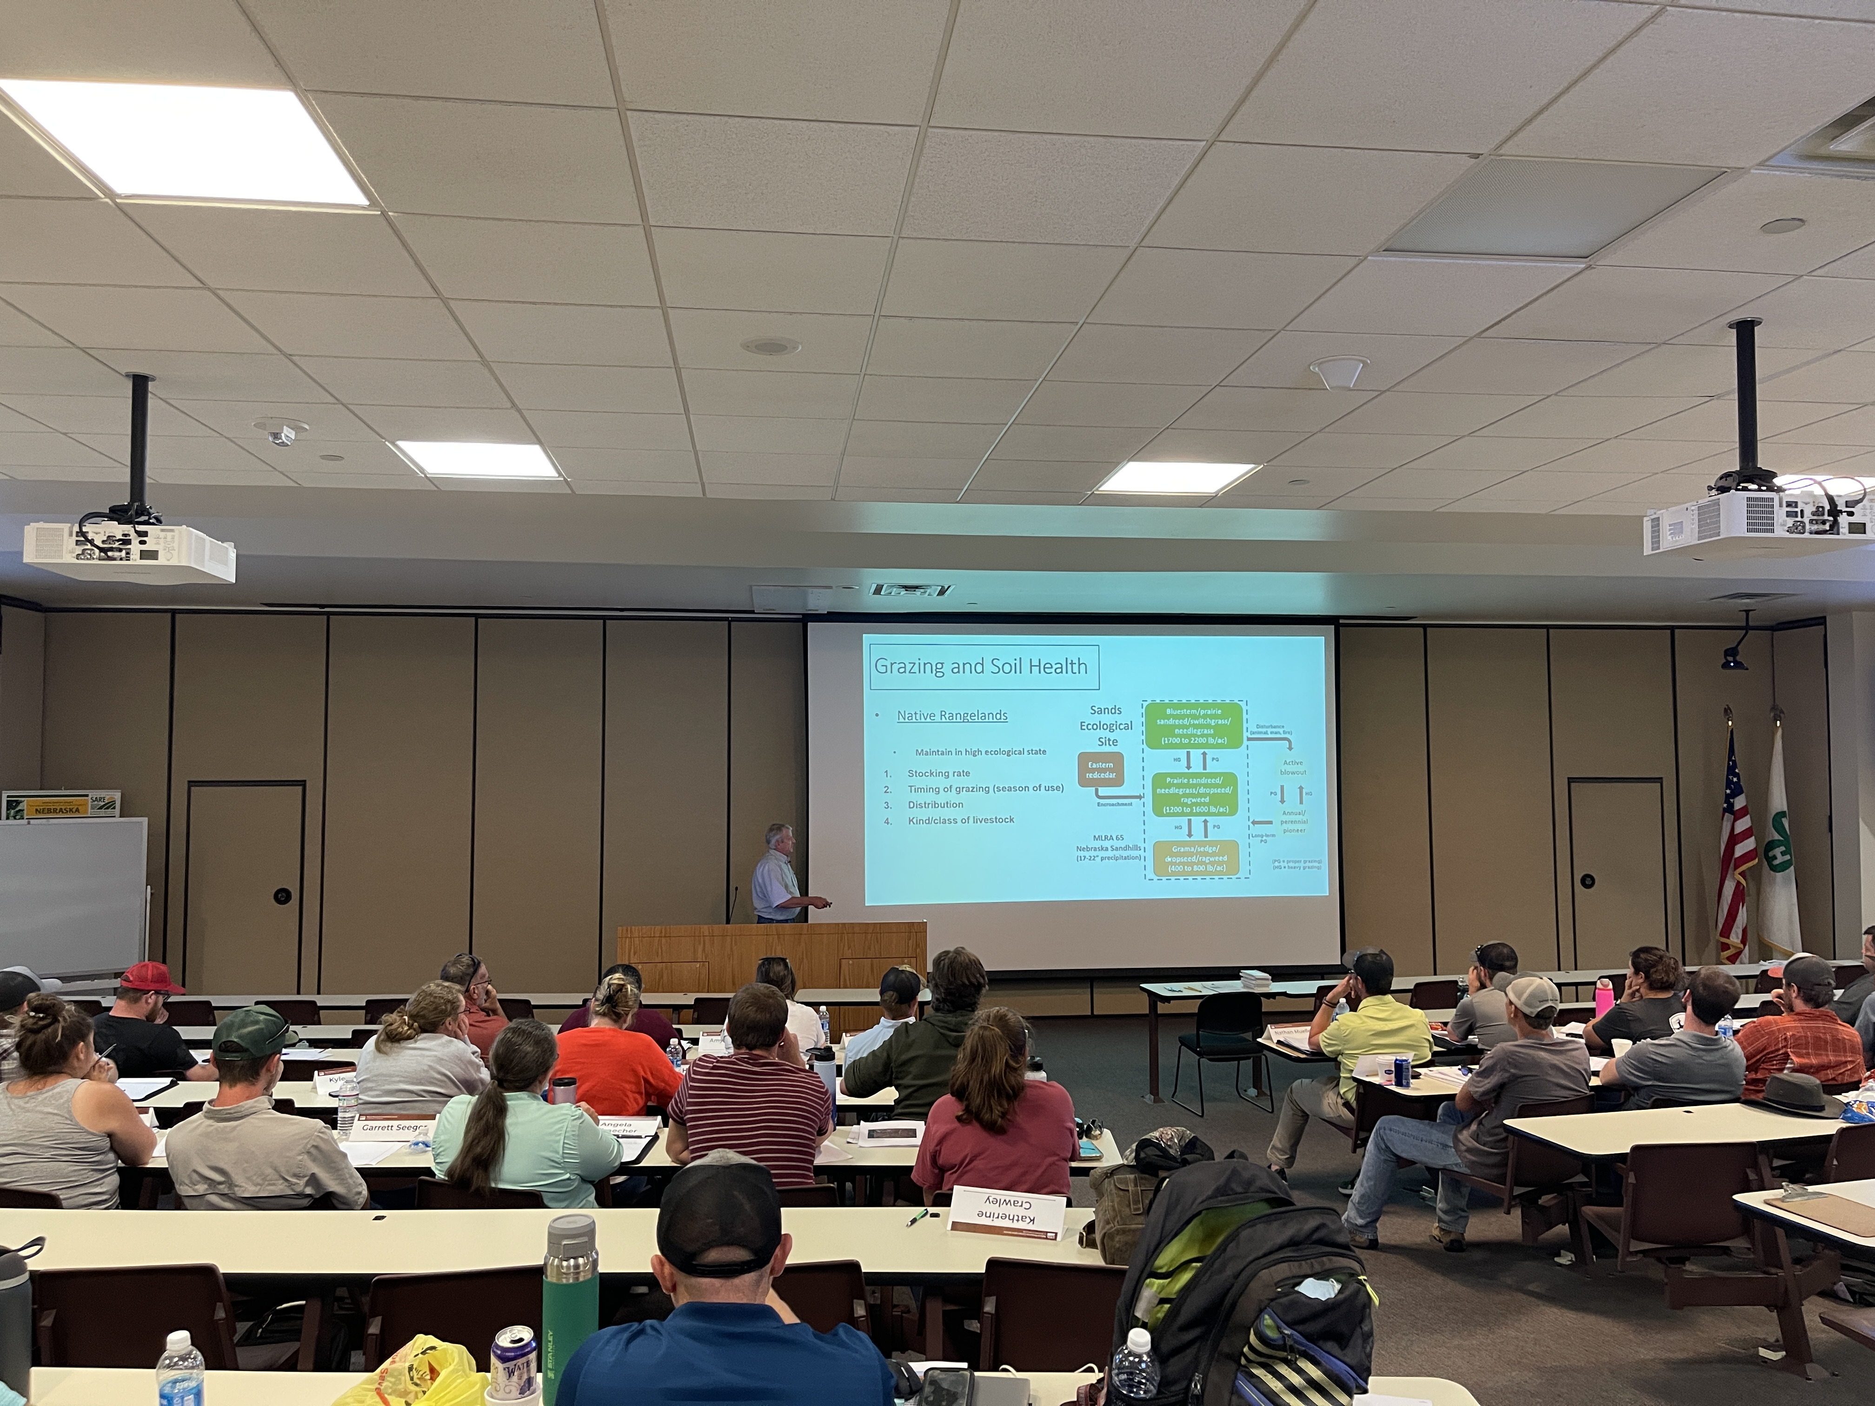
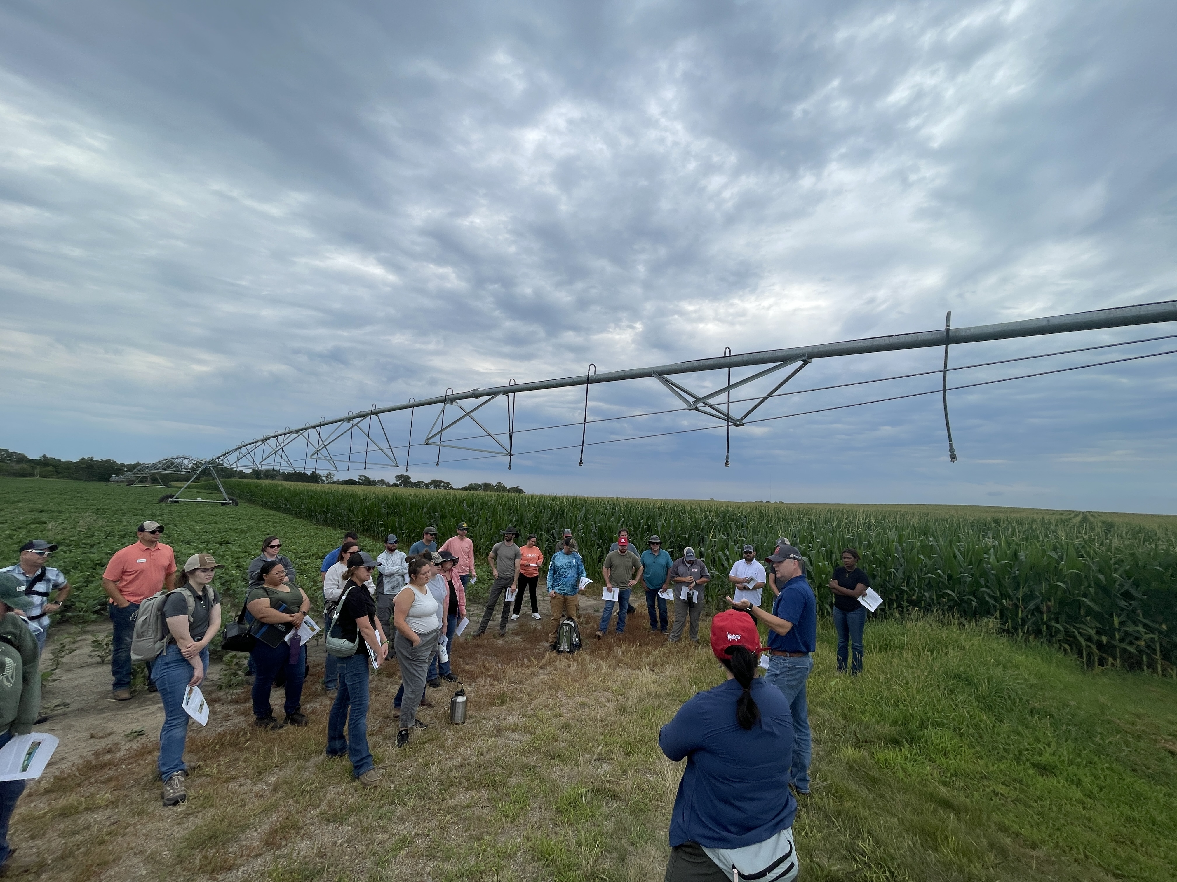
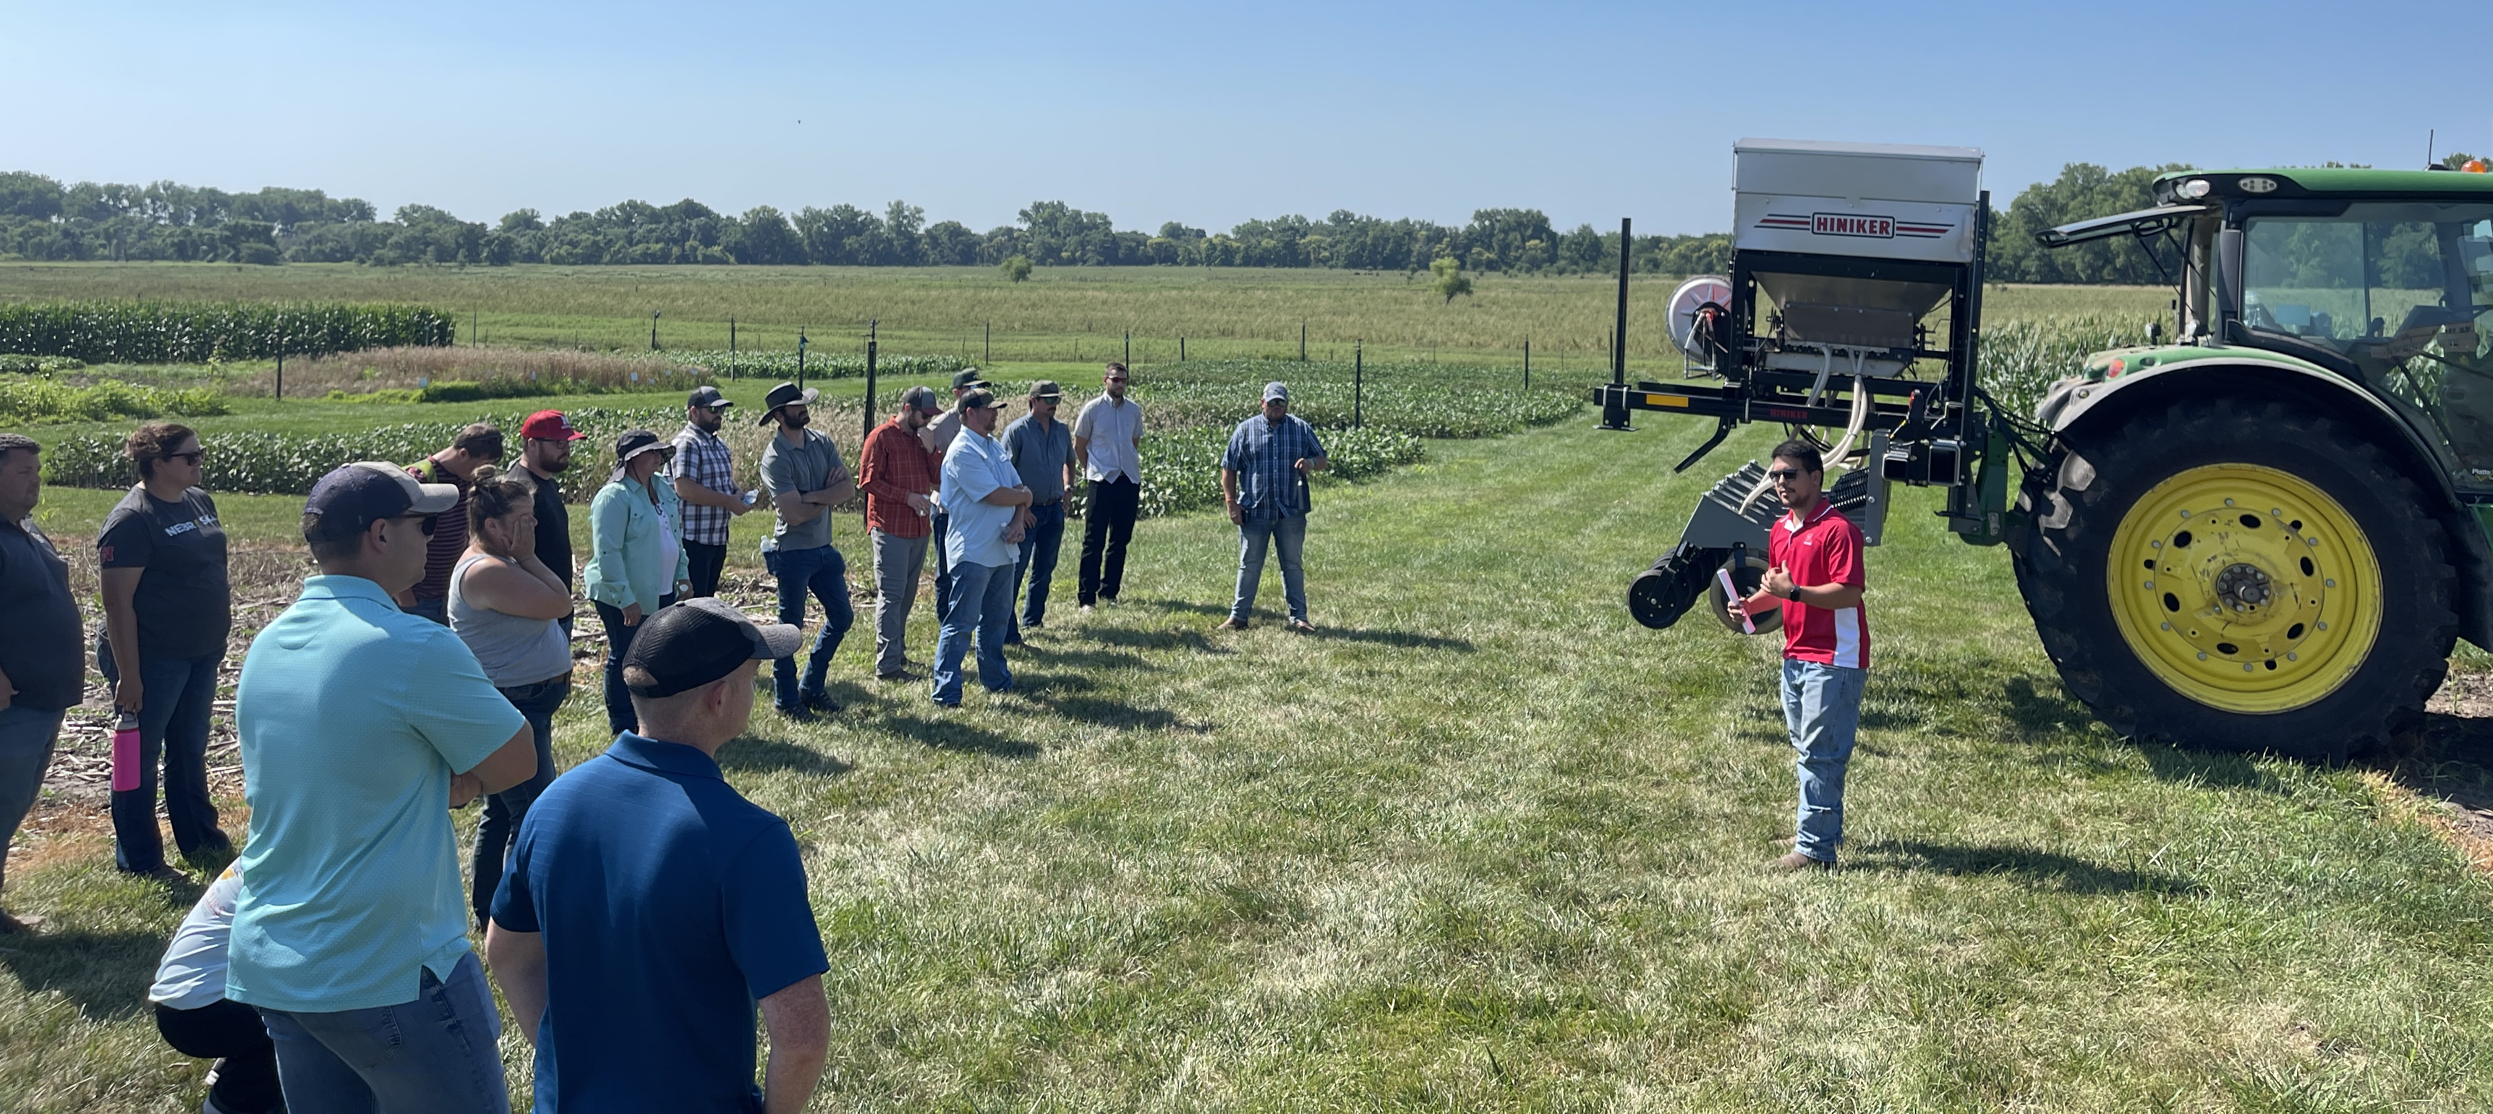
2024 NRCS Soil Health & Sustainability Training for Field Staff

Slide 18
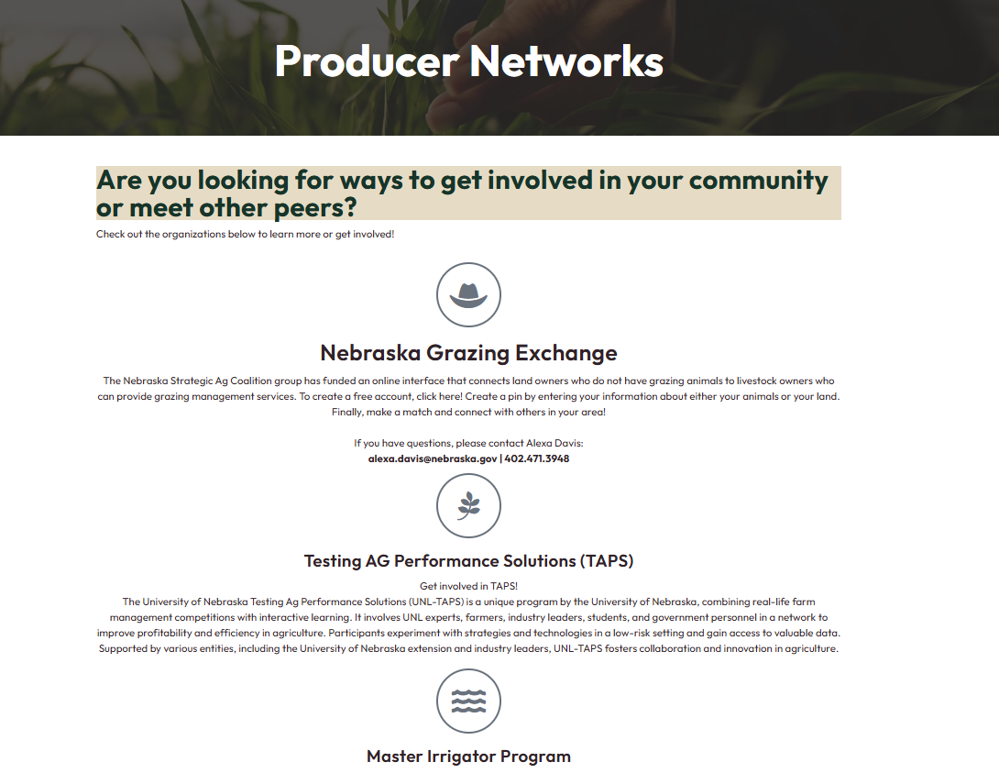

Slide 19
Vision for the Website/ Aspirations for NSAC
For the Website
Bringing All of Ag to the Table
Finding a Long-term Steward
Website Advisory
Stakeholder Engagement & Outreach
For NSAC
Capacity Building
Space for Cross Collaboration

Slide 20
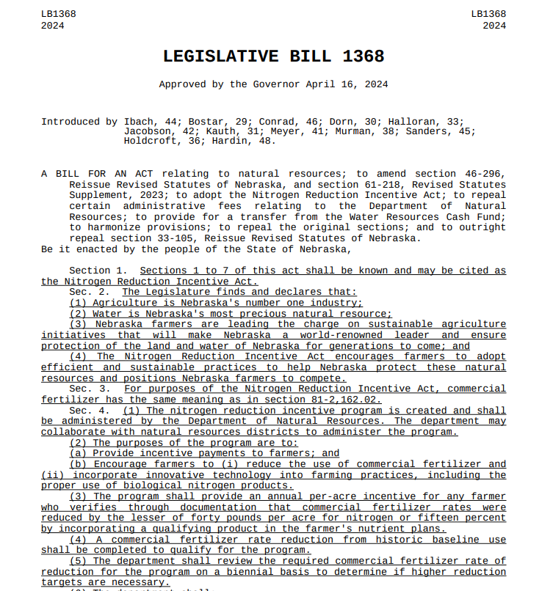
Nitrogen Reduction Incentive Act

Slide 21
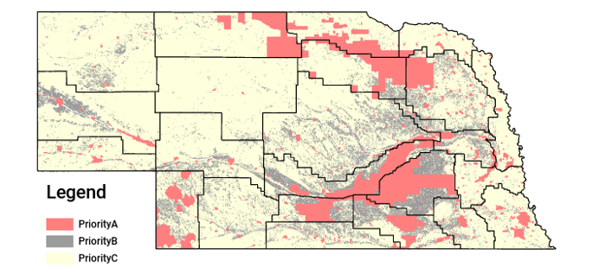
Initial Interest
Over 1,300 applications totaling a little less then to $2 million

Slide 22
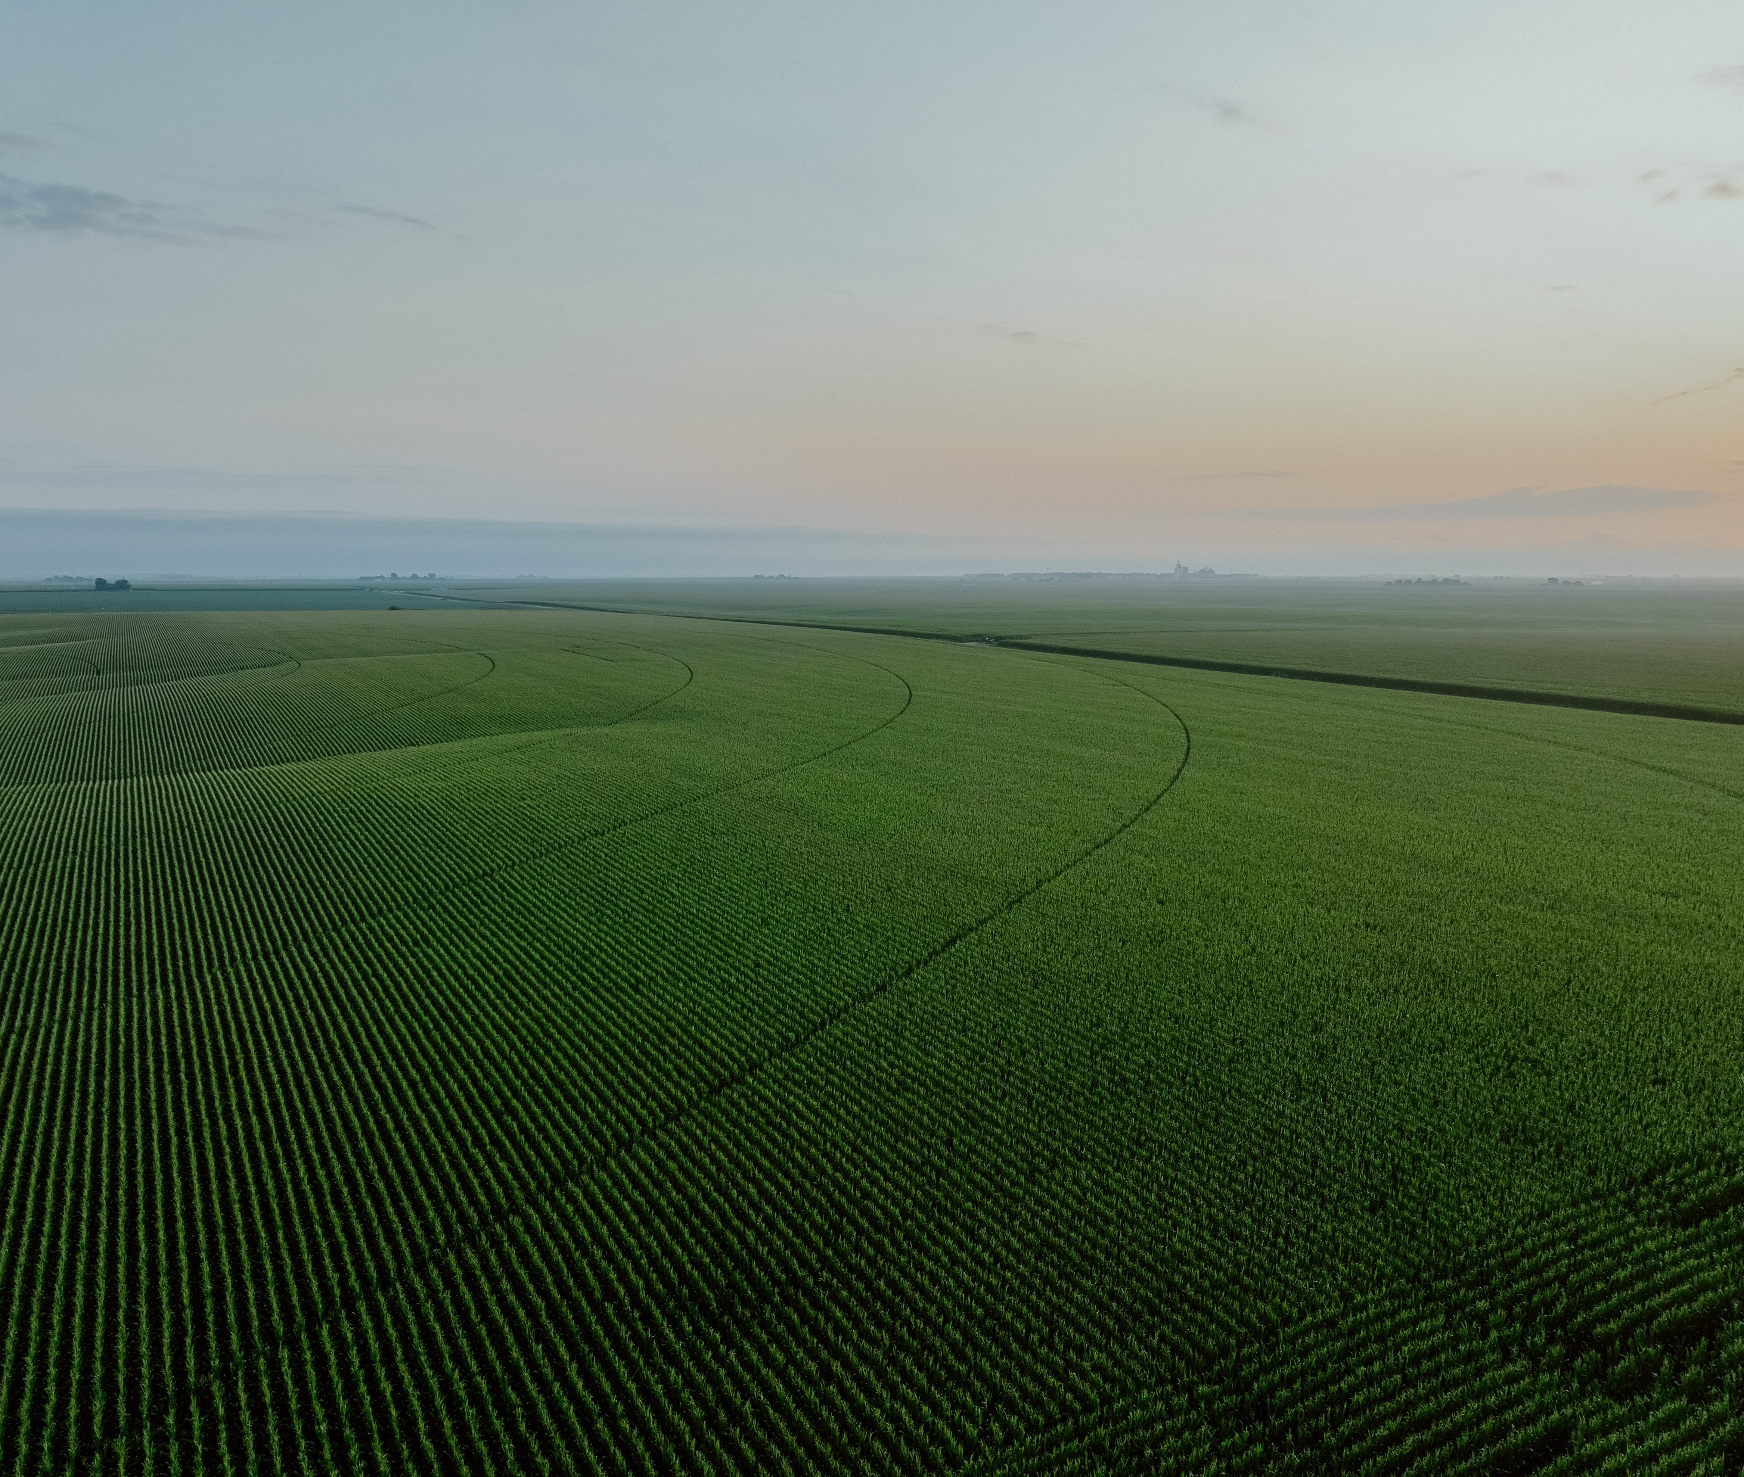
Thank You For Listening
Alexa Davis
Soil & Water Conservation Coordinator
NE Department of Natural Resources
Alexa.Davis@nebraska.gov
(402) 471-3948
Questions?

