Slide 1
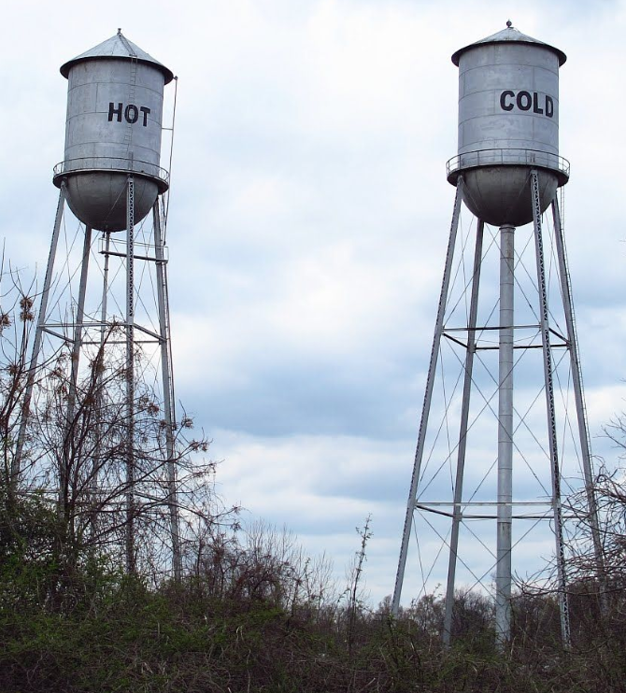


Manganese in Nebraska drinking water
Sue Dempsey, state drinking & ground water administrator

Slide 2

Presentation Outline
    Why an assessment for manganese?
    What level(s) does Nebraska consider high?
    Manganese sampling event
    Manganese sampling results

Slide 3
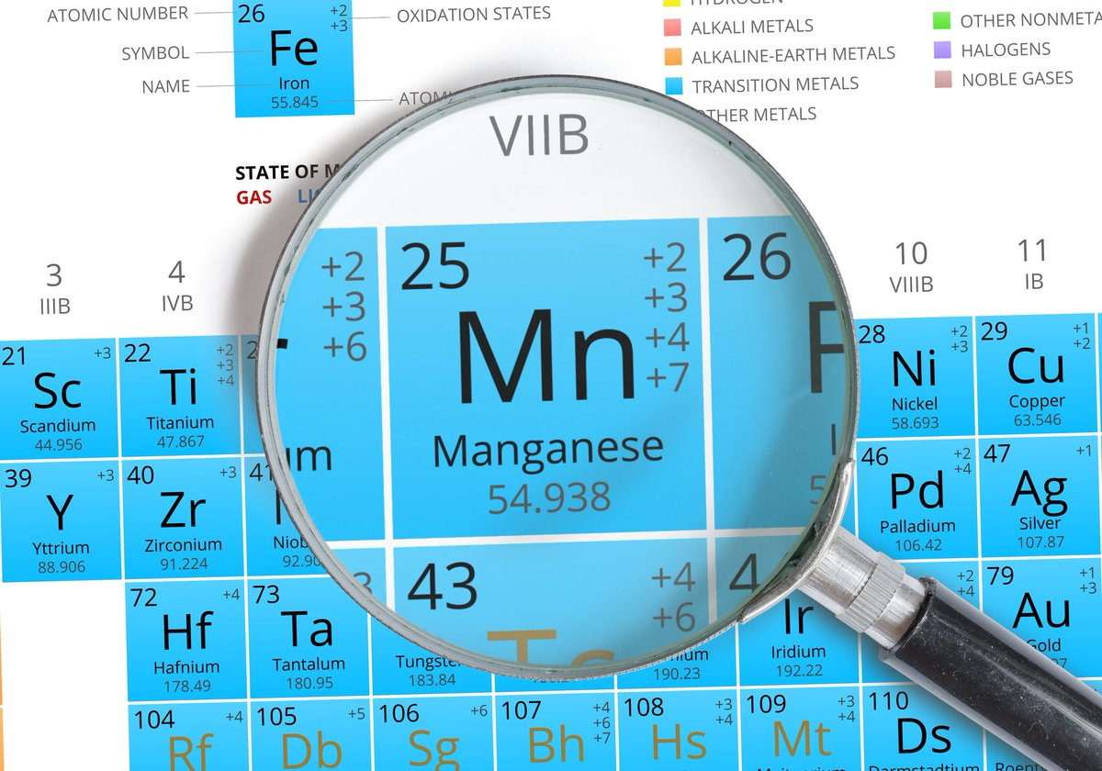
Why an assessment for manganese?
  Manganese is a naturally-occurring essential nutrient at low levels but at high levels it can negatively impact the nervous system.
  It is currently not regulated or routinely tested for.
  Prevalence across the state, until now, was previously unknown.

Slide 4
What Mn levels are considered high in ne?
  Water containing 50 μg/L can have an off taste, smell, and color. Drinking water with manganese at this level would not have a negative health impact.
  Water containing 300 μg/L should not be used to make infant formula, since infant formulas, particularly rice and soy already contain high levels of manganese. Use treated or alternative water. PUBLIC NOTICE
  Calculated mean Mn intakes from SB/RB by infants, 0.78 L formula/day, approached the Tolerable Upper Intake Level (UL). See reference.
  Water containing over 1,000 μg/L should not be consumed by anyone in the community and may negatively impact the nervous system. Use treated or alternative water. PUBLIC NOTICE

Slide 5

Manganese Sampling Event (Spring 2020)
Sample kits were mailed to all (584) systems serving >10,000 ppl.
Kits, sample analysis, and return postage was paid.
96% Participation rate in this voluntary sampling event.
Results were used to:
  Provide public notice per EPA & State recommendation.
  Prepare a GIS map to identify geological formations & depth for high Mn levels.
  Encourage private well owners in these areas to test.
  Inform communities when new wells are proposed.

Slide 6
Manganese sampling results
515 Systems serving <10,000 participated
EPA sampled those serving >10,000 (treatment plants in place)
1,334 sample kits sent
64 Public notice advisories issued (300-999 μg/L Mn)
6 Public notice advisories issued (>1,000 μg/L Mn)
27 Treatment plants removing manganese to safe levels (no public notice)

Slide 7
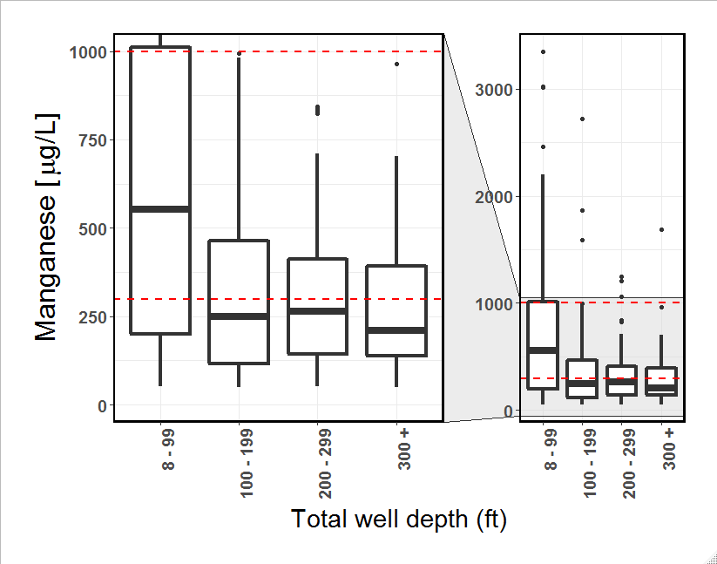
Most of the highest concentrations were detected in wells less than 100 feet deep.
Although rare, high concentrations were detected at all depths examined.

Slide 8
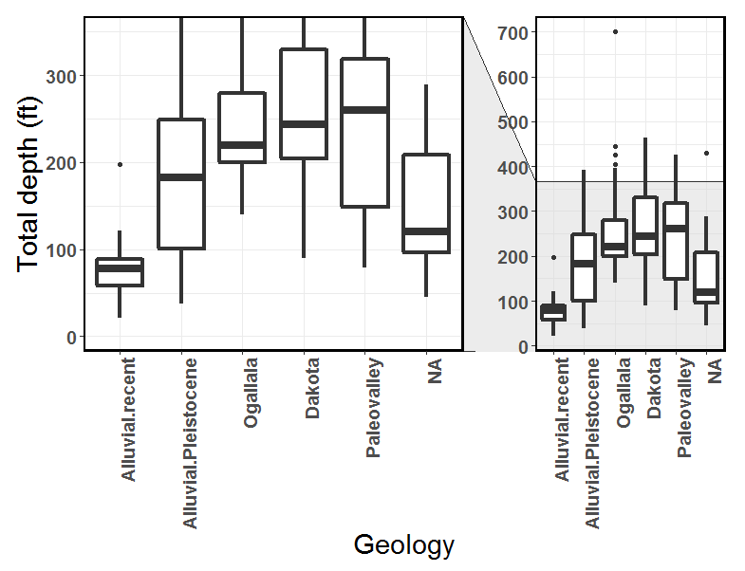
The wells drawing from recent alluvial deposits were almost all less than 100 feet deep.
Statistically, the recent alluvial wells were shallower than all other wells.
It is important to make sure that detected differences in manganese among the formations are not being mistaken for differences in well depth.

Slide 9
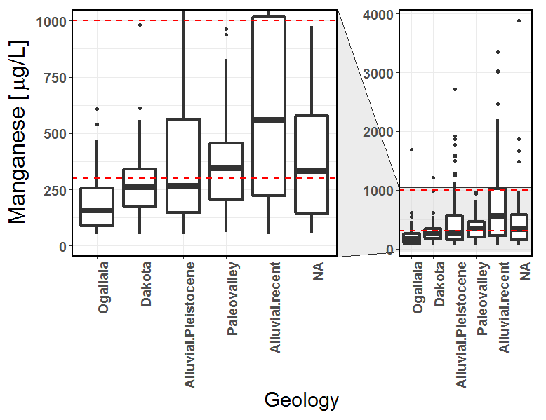
The wells drawing from the recent alluvial deposits typically had the highest concentrations of manganese.
Most of the wells exceeding 1,000 µg/L were drawing from the Pleistocene and recent alluvial deposits.
It appeared that the manganese differences among the geology of the wells did not match the depth differences among wells, as Paleovalley wells were quite deep and also had relatively higher concentrations of manganese.

Slide 10
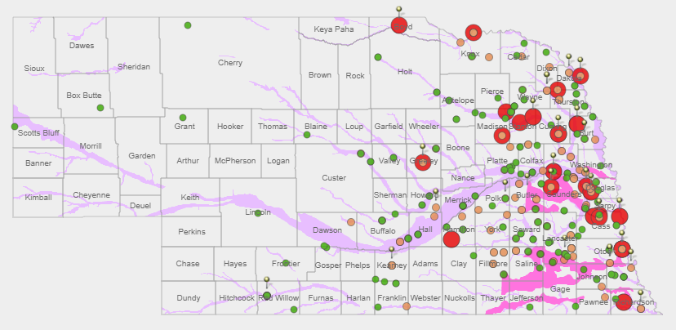
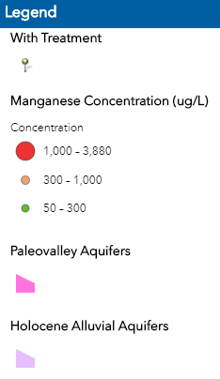
http://nedhhs.maps.arcgis.com/apps/webappviewer/index.html?id=d3db12ac3e5147beb0156ec7c9f3fbab

Slide 11
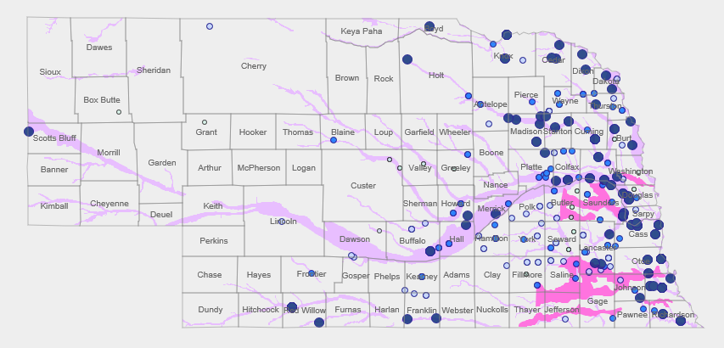
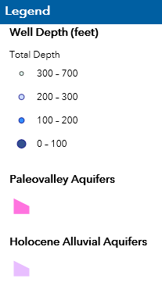
http://nedhhs.maps.arcgis.com/apps/webappviewer/index.html?id=6045ae72d7f045a99d28625c3a938103

Slide 12

Sue.Dempsey@Nebraska.gov
Sue Dempsey
402-471-0510

