Slide 1
Interpretation of Hydrogeologic Data to Support Groundwater Management, Bazile Groundwater Management Area
A case demonstration of the Nebraska Geocloud
Chris Hobza, Lead Hydrologist, P.G.
With contributions from:
Sue Lackey, Dan Snow, Jesse Korus, and Katie Cameron
April 13, 2021
Notes:
Interpretation of Hydrogeologic Data to Support Groundwater Management, Bazile Groundwater Management Area, Northeast Nebraska, 2019—A Case Demonstration of the Nebraska Geocloud

Slide 2
Acknowledgements
Funded by Nebraska Water Sustainability Fund, 10 Natural Resources Districts, USGS Cooperative Matching Funds
Other technical contributors
  Sue Lackey
  Dan Snow
NRD staff providing groundwater recorder data
  Joslynn VanDerslice (UENRD)
  Josh Schnitzler and Brian Bruckner (LENRD)
  Myles Lammers (LCNRD)

Slide 3
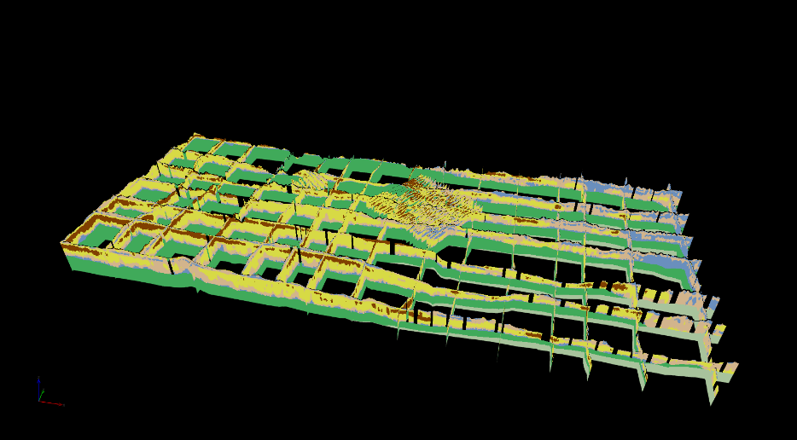

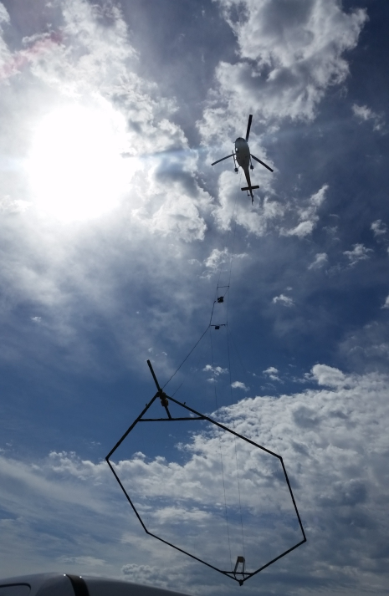
The need for Nebraska Geocloud
As of 2017, no systematic effort to assemble, preserve, and share AEM and supporting data
Standards have not been adopted for data quality
Little work has been done to develop guidelines to apply AEM data collection for specific groundwater management applications
Bazile GWMA
Sections courtesy of Jim Cannia, AGF
Image from http://enwra.org/2016aem.html
Notes:
Since 2007, Nebraska has spent nearly $10 million in AEM surveys

Slide 4
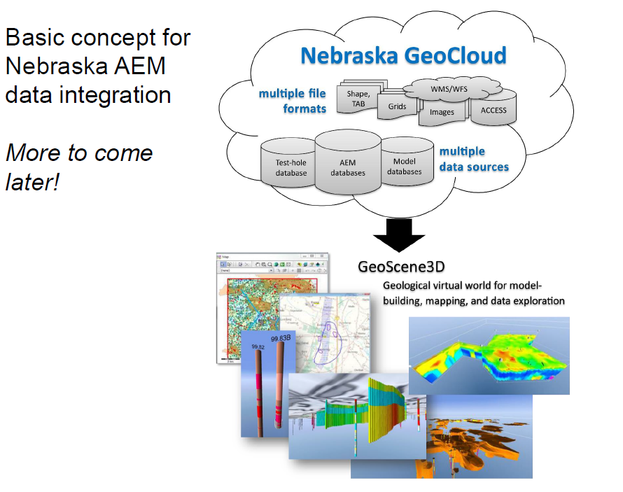

Notes:
Assemble, quality assure and store geologic data from various formats

Slide 5
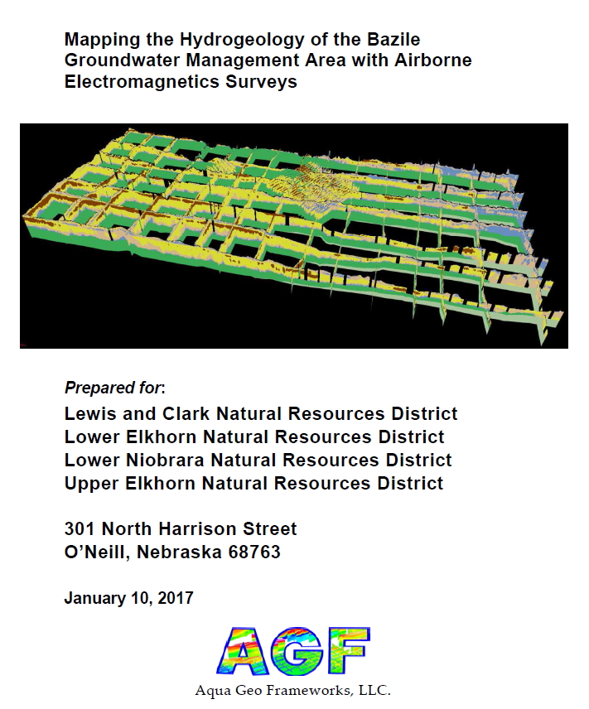
Bazile AEM survey
644 line-miles with SkyTEM 304M
  Denser block flights near Creighton and West Knox water systems
  Included 108 line-miles collected in 2014 by LENRD and ENWRA
Delineated coarse aquifer, aquifer, marginal aquifer and nonaquifer materials along flight lines
Mapped high recharge zones by examining shallow resistivity
Cannia and others, 2017

Slide 6
Bazile Groundwater Management Area focused study
Data aggregation and comprehensive interpretation with an improved hydrostratigraphic framework
Assess the ability of AEM to detect and map important hydrogeologic contacts and boundaries
Identify data gaps and suggest future data collection activities to inform groundwater management

Slide 7
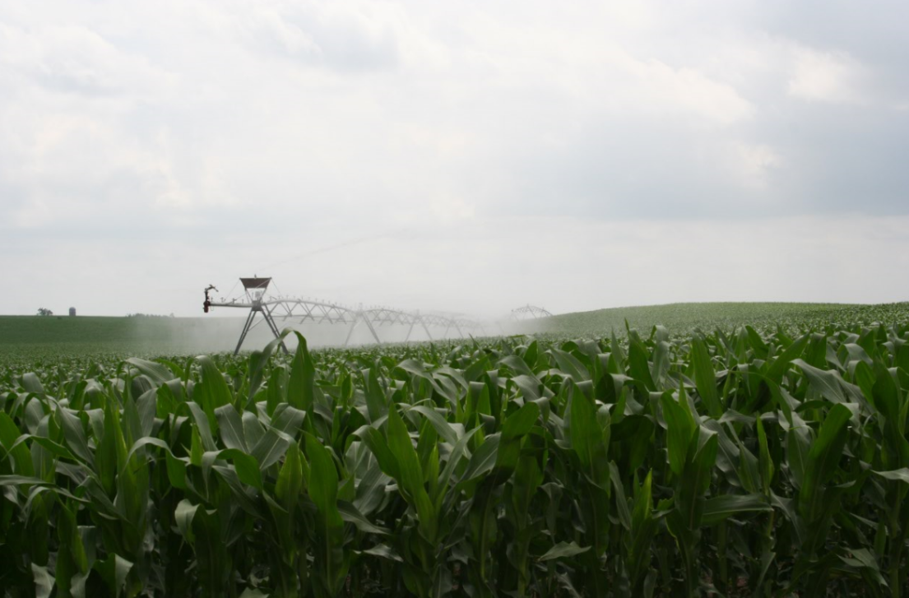
Quality-assured publicly available data sources
AEM data collected in 2014 and 2016
CSD test-hole data
DNR well logs
  Driller’s logs
  Well construction
Water-quality data
Groundwater level
  Spring 2017 discrete water levels
  Continuous groundwater levels
Notes:
Assembled additional data sources for comprehensive interpretation using the improved geologic framework as additional context

Slide 8
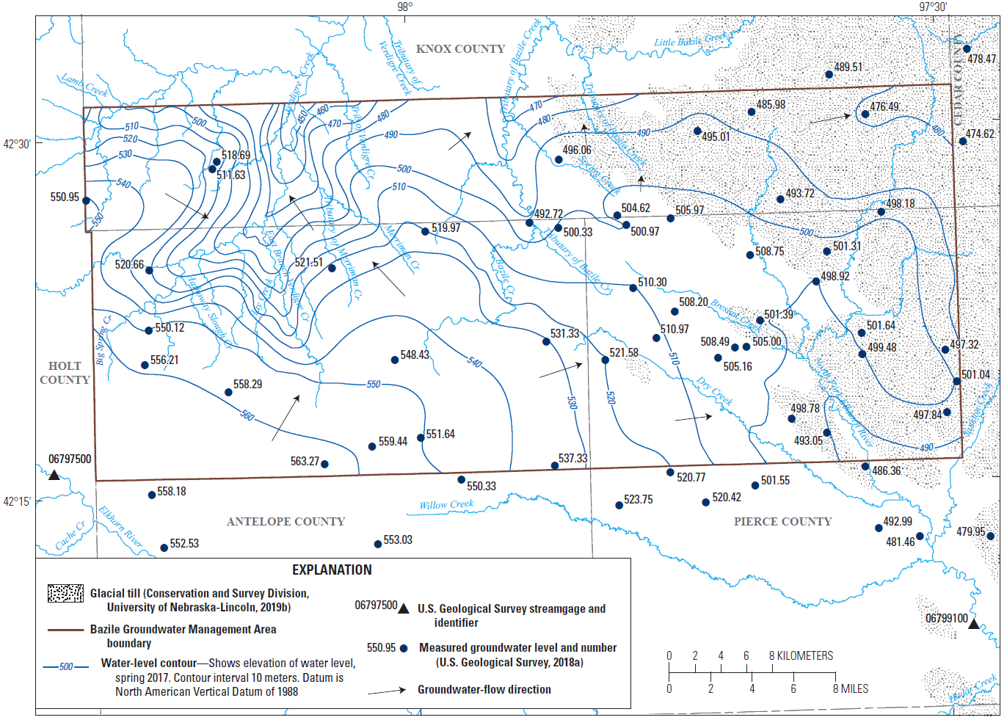
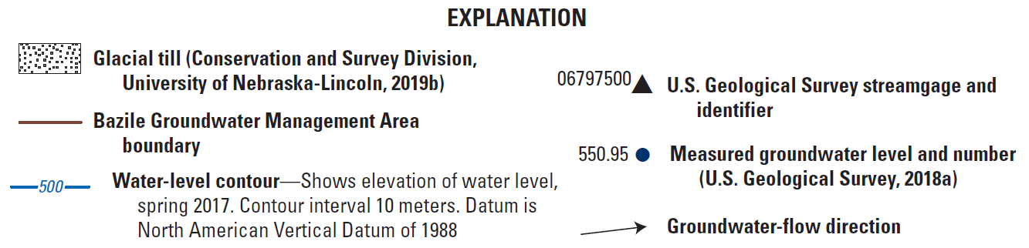
Spring 2017 water-level map

Slide 9
Groundwater quality data sources
USGS NWIS database
Agrichemical clearinghouse
59 samples collected within BGMA from 1953 to 2015
Comprehensive suite of analytes but poor spatial coverage
Collected for focused studies related to land use and GW quality
Incorporated previously unpublished age tracer data (UENRD in 2003 and LENRD in 2007)
Over 8,000 sample results collected from 1976 to 2016
Sampling data often collected annually by NRDs (assess temporal changes)
Nearly 8,000 nitrate sample results that provide excellent spatial coverage, but report only nitrate (dissolved oxygen, water level not reported)
Notes:
Repeated sampling can document temporal changes in nitrate

Slide 10
Groundwater age tracers
Concentration ~ groundwater age
Generally speaking, the concentration of these constituents is well characterized and varies over time
“Young” tracers:
  Tritium (³H)
  Tritium-helium
  CFCs (chlorofluorocarbons)
Groundwater greater than 50 years old considered “pre-modern”

Slide 11
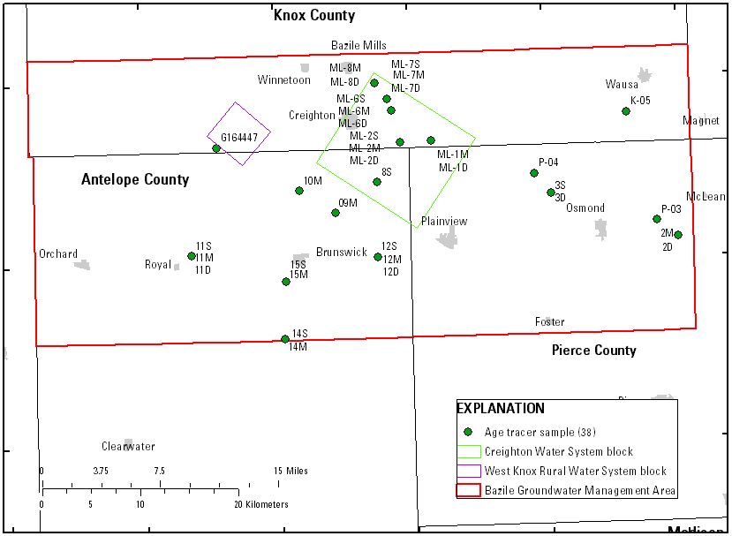
BGMA age tracer samples
ML-6S
ML-6M
ML-6D
15S
15M
Age tracer studies:
Burbach and Spalding, 2001
Snow and Miller, 2018
Steele, 2003 (previously unpublished)
Steele, 2007 (previously unpublished)
Stanton and others, 2007

Slide 12
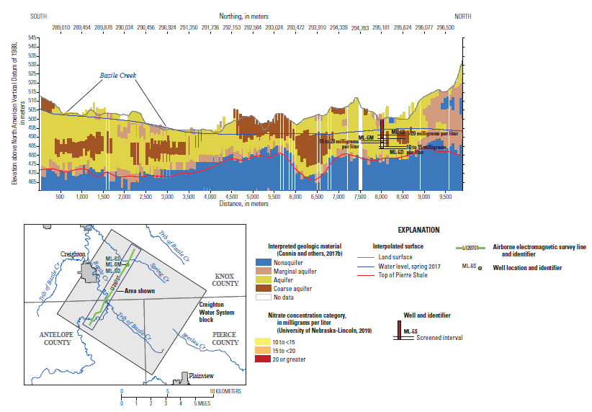
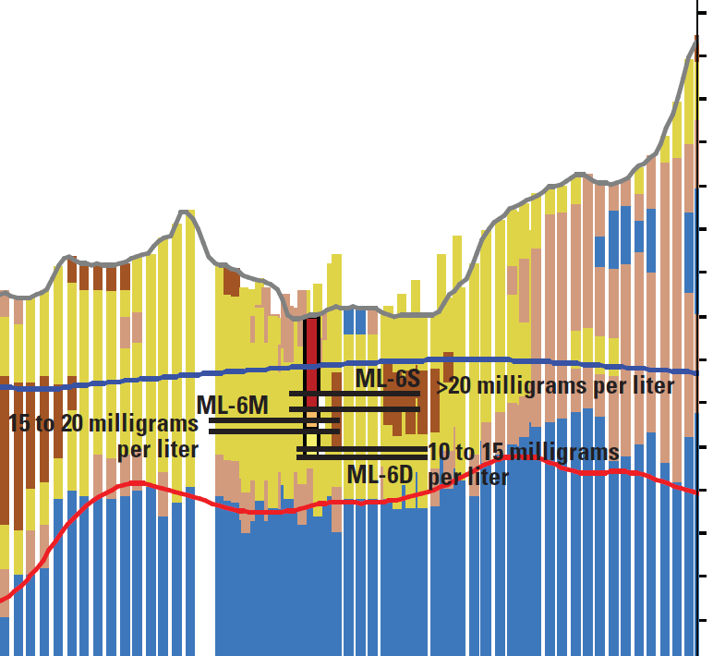
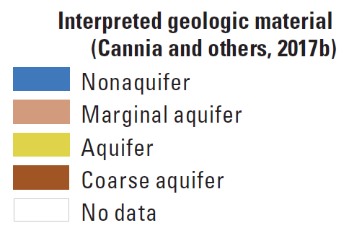
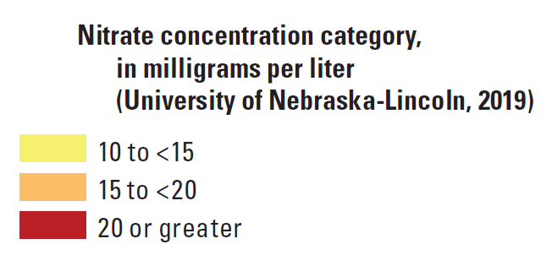
Age tracer and nitrate data (Creighton block area)
Spring 2017 water table
Top of Pierre Shale
ML-6S >20 mg/L
22 years
ML-6M
15 to <20 mg/L
ML-6D 10 to <15 mg/L
28 years
25 years
Notes:
All PP gravel
Aquifer is overlain by coarse sediments, thin unsaturated zone
Aquifer is relatively thin composed of coarse deposits
High nitrate, young groundwater present throughout aquifer, CFCs were used as the tracer

Slide 13
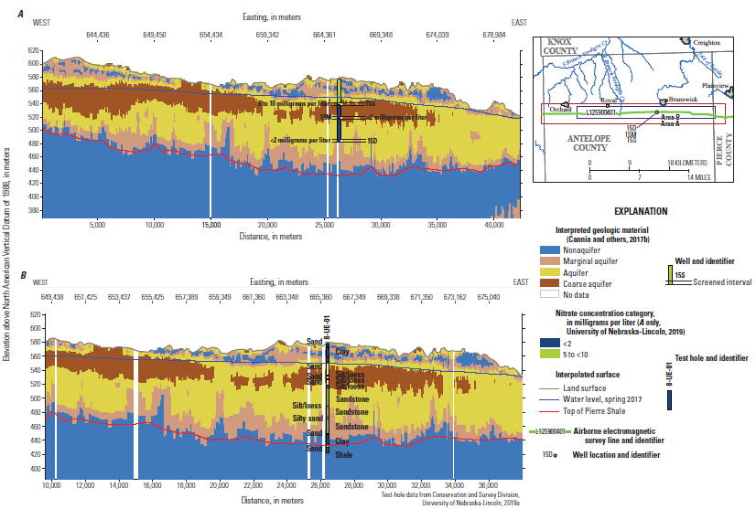
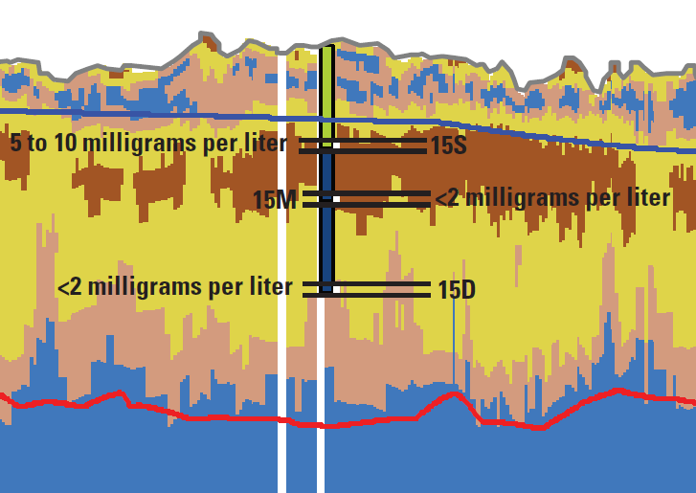
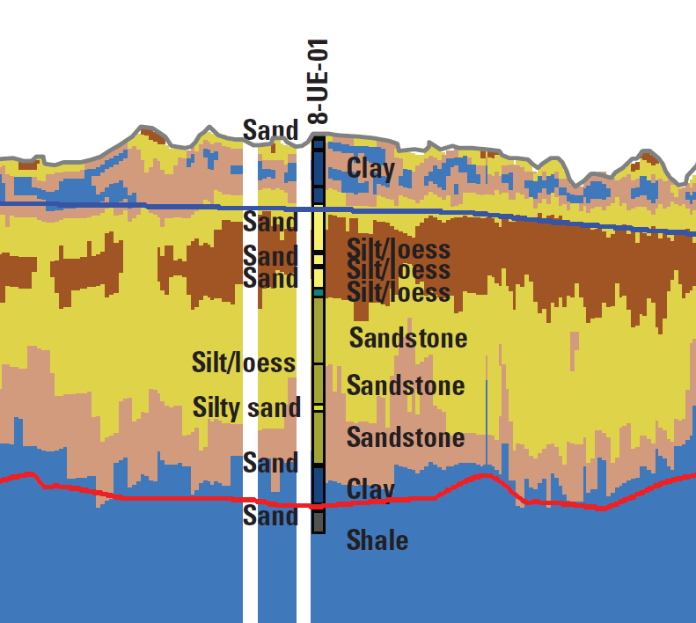
Age tracer and nitrate data (Upper Elkhorn NRD)
15S 5 to <10 mg/L
38 years
15M <2 mg/L
> 50 years
15D <2 mg/L
> 50 years
Layers of silt separate
screened intervals
Thin fine-grained layers not resolved
by AEM
Fine-grained layers may slow or prevent
movement of high nitrate groundwater
Notes:
08-UE-01 (Brunswick-SW)
15S, TD=132 ft is P-P S&G,
15M TD=197 ft is top of To(beneath ~4 ft of To clay, silty), and
15D TD=312 ft is the middle of To. (K=493 ft)
Shallow aquifer shows some nitrate contamination in well 15S
6 meters or 20 feet of silt and loess separate the shallow and medium well;
AEM not detecting these layers, continued sampling of wells 15M and 15D are needed to determine if nitrate threatens deeper GW

Slide 14
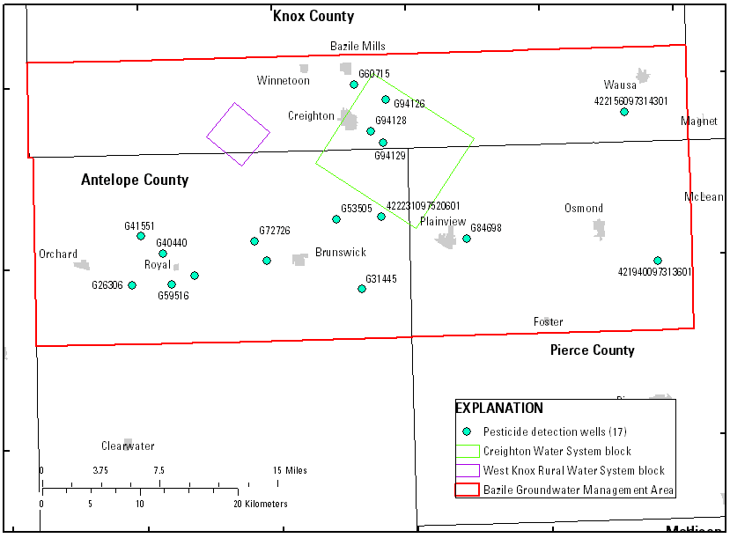
Pesticide detections in groundwater
Creighton Water System block
Interpreted paleochannel

Slide 15
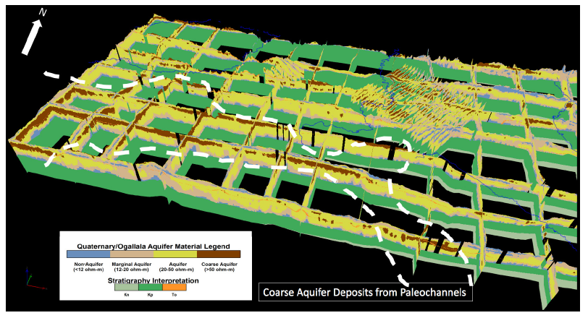
Interpreted paleochannel (Cannia and others, 2017)
Paleochannel

Slide 16
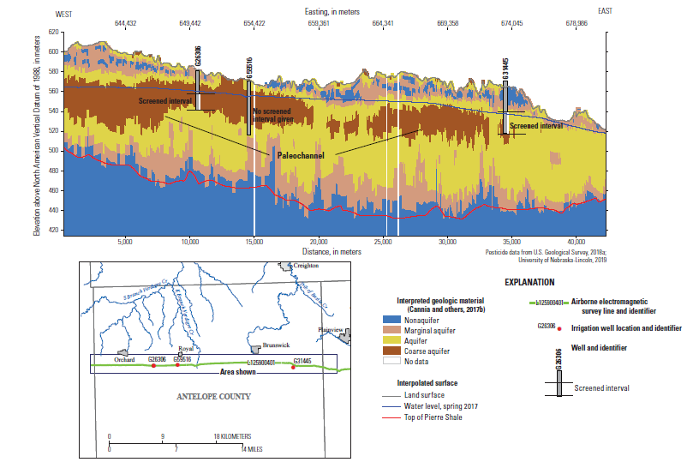
Pesticide detections
Thin, discontinuous vadose zone
Paleochannel
Notes:
Hits of pesticides were detected in two locations; Near Creighton water system the other location is above where AGF interpreted a paleochannel the outcrops near surface

Slide 17
Significant findings from water-quality data
Shallow groundwater indicated to be “young” with elevated concentration of nitrate
Deeper groundwater often is greater than 50 years with nitrate below background (2 mg/L)
Well logs indicate screens separated by fine grained layers; however, these layers are often not mapped with AEM
Without water-level data, unsure of how effective of a hydraulic barrier these fine grain layers are

Slide 18
Interpretation of groundwater level data
Examined groundwater level hydrographs from 15 wells in BGMA
Nearly all wells affected by seasonal groundwater pumping
The collection of continuous groundwater levels from multiple wells within a well nest provided the most useful information
Examine the hydraulic connectivity of shallow and deeper parts of the aquifer

Slide 19
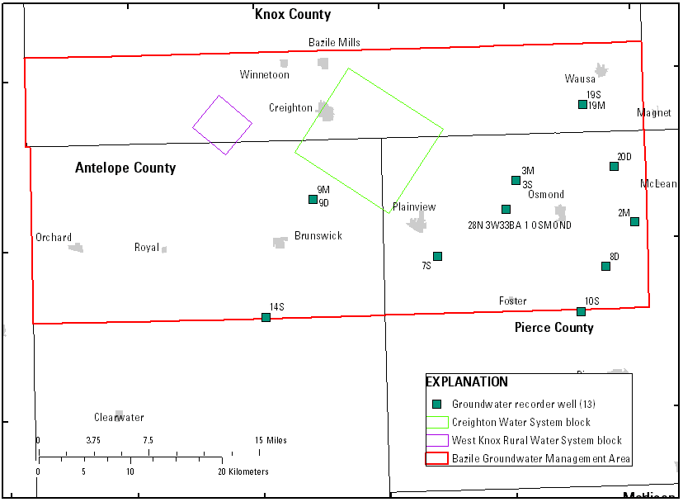
Interpretation of continuous groundwater levels
19S
19M
3S
3M
9M
9D

Slide 20
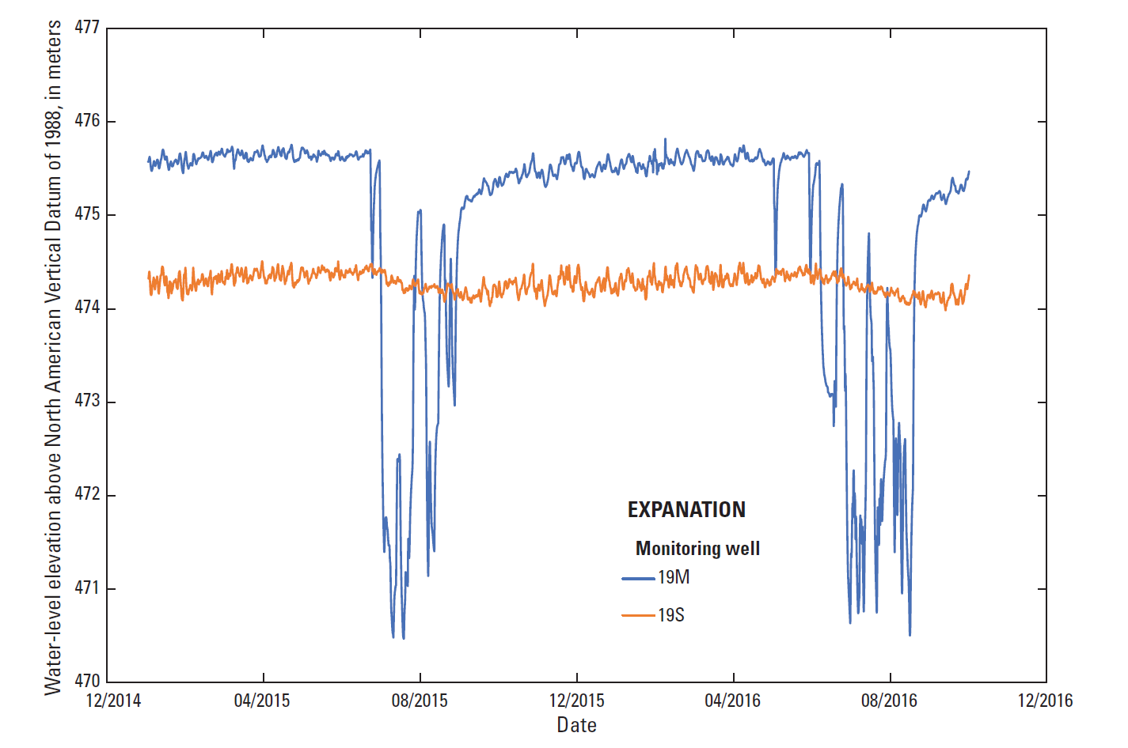
Continuous groundwater levels

Slide 21
Monitoring wells 19S and 19M (LENRD)
During summer months gradient switches, now downward movement (recharge)
During non-summer months net upward
movement of groundwater (discharge)
Varying water-level responses indicate hydraulic confinement
Let’s look at the AEM data…

Slide 22
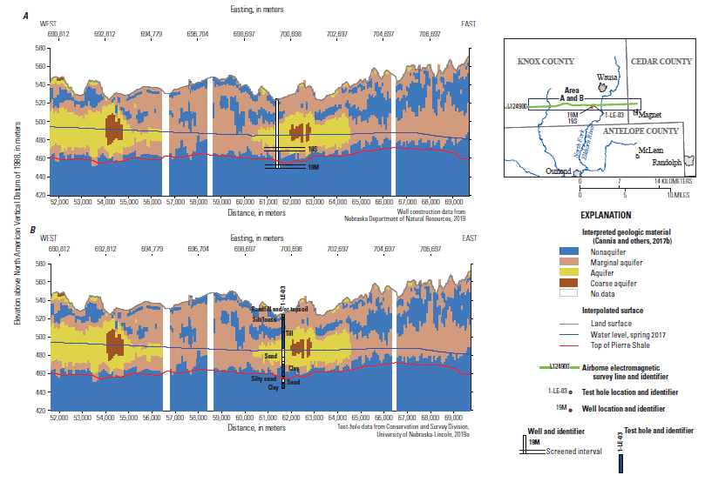
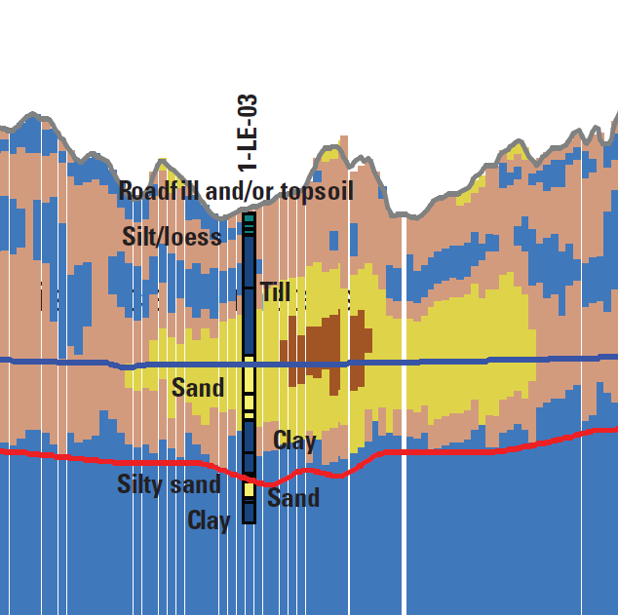
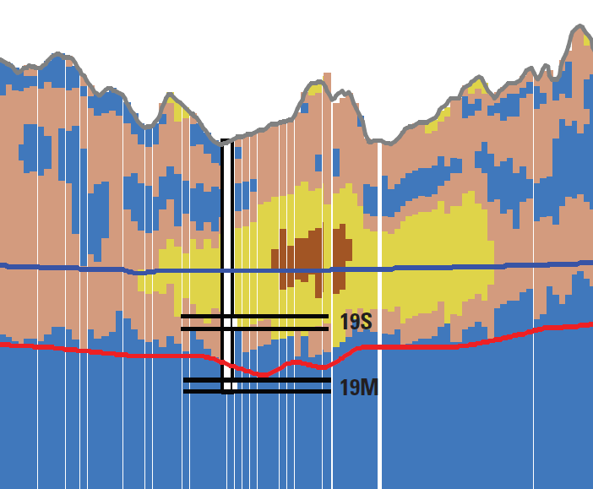
Monitoring wells 19S and 19M
Well screens separated by
thick clay layer
Notes:
01-LE-03 (Wausa SW)
19S TD=180 ft is P-P Sand w/ Grv near water table ~160 ft,
19M TD=245 ft is P-P Sand w/ grv near base (K=247.5 ft)

Slide 23
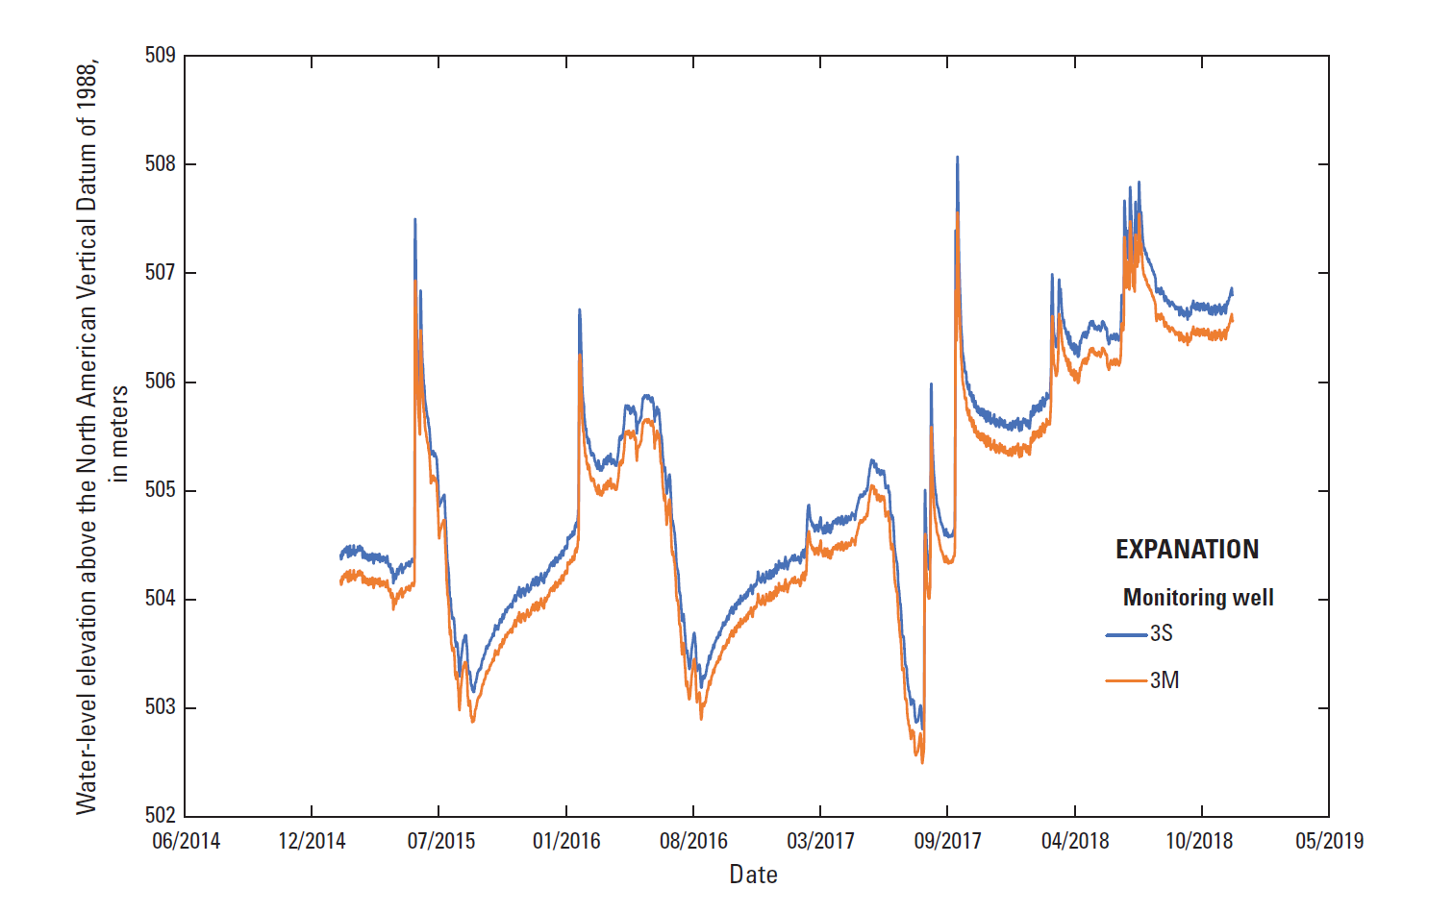
Monitoring wells 3S and 3M (LENRD)
Nearly identical water-level response to hydrologic stresses
Net downward movement of groundwater (recharge)
Indicates no hydraulic confinement of the lower aquifer

Slide 24
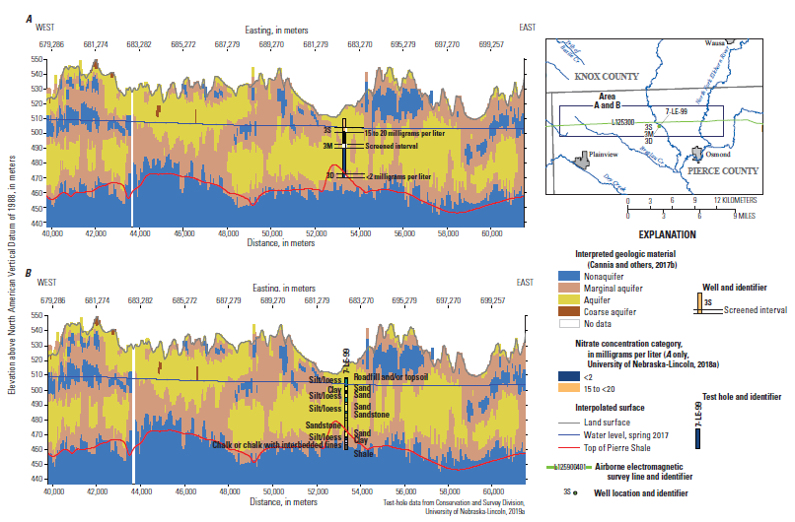
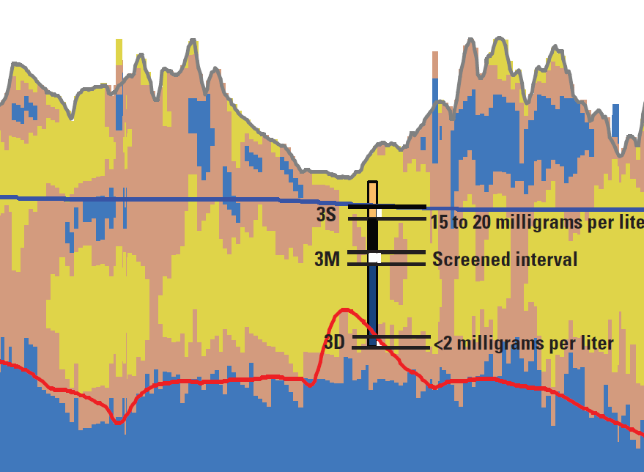
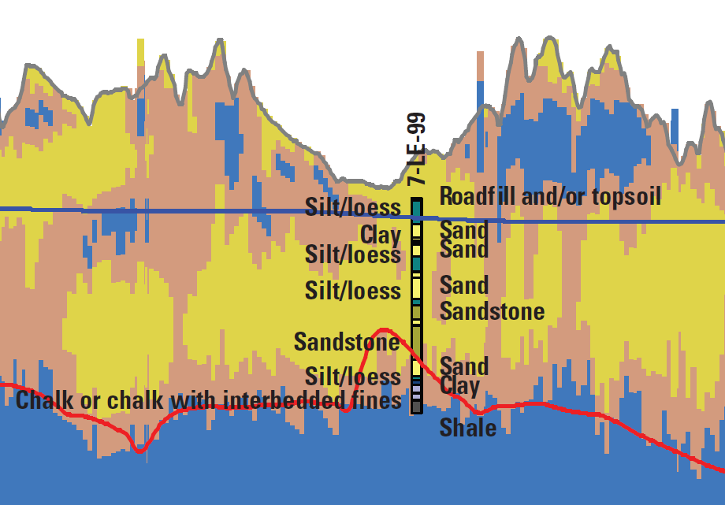
Monitoring wells 3S and 3M (LENRD)
Thin interval of clay
ineffective confining layer
3S 15 to <20 mg/L
20 years
3M <2 mg/L
3D <2 mg/L
> 50 years
Notes:
07-LE-99 (Osmond NW)
3S TD=30 ft is P-P sand w/ gravel
3M TD=71 ft is top of To (No silt/clay layer between sands.)
3D TD=131 ft is near base of To

Slide 25
Monitoring wells 3S and 3M (LENRD)
With net downward movement of groundwater and unconfined conditions, nitrate is expected to move to deeper parts of the aquifer
Without dissolved oxygen data in well 3M, the role of denitrification is unknown

Slide 26
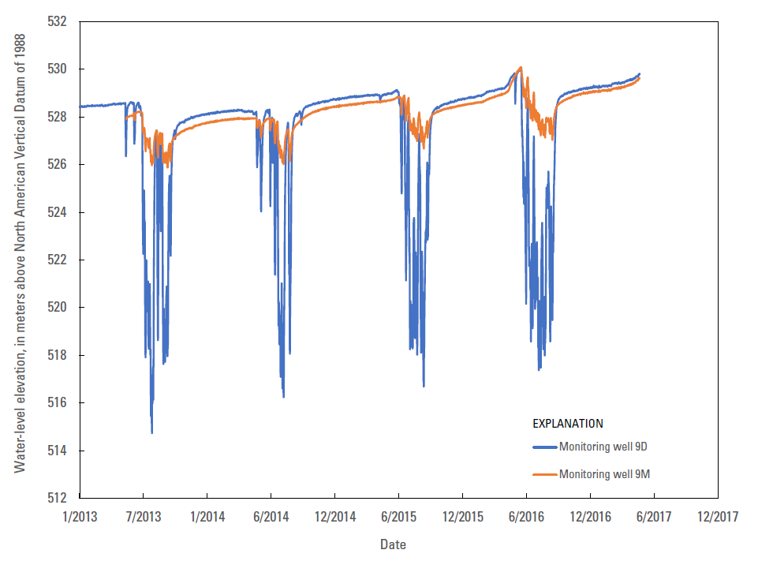
Monitoring wells 9M and 9D (UENRD)
Water-levels show similar responses
Summer months gradient changes, net downward movement (recharge)
Let’s look at the AEM and
water-quality data…

Slide 27
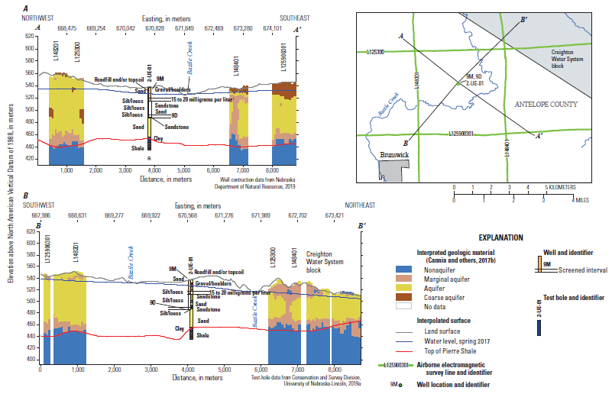
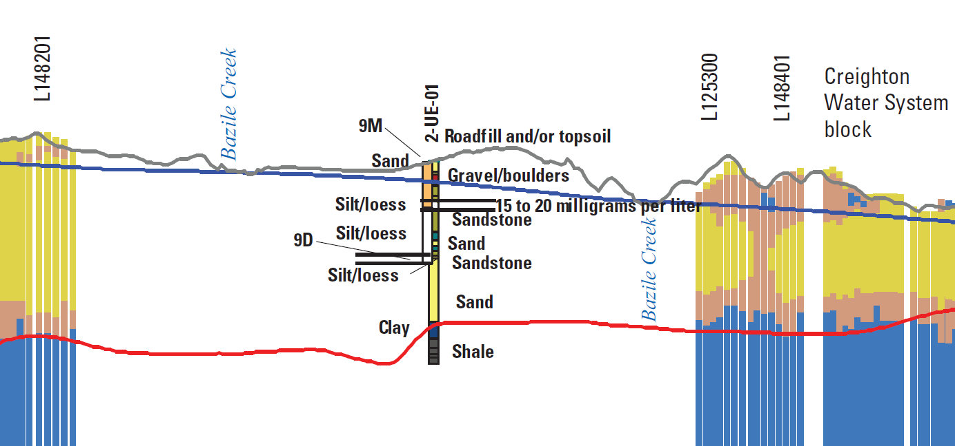
Monitoring wells 9M and 9D (UENRD)
Some layers of silt
9M 15 to <20 mg/L
23 years
Notes:
2-UE-01 )(Ebel’s) [SLIDE 30]
9M TD=78 ft is top of To (Thin Q S&G then 4 ft of silt, clyey to sdy @base on top of To sd.),
9D TD+165 ft is middle of To (K=298 ft).

Slide 28
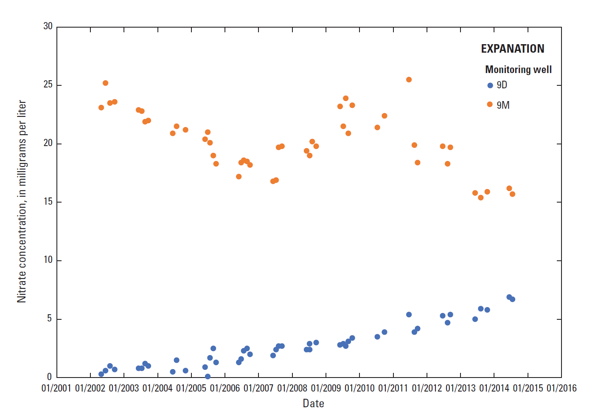
Monitoring wells 9M and 9D (UENRD)
Downward movement of groundwater affecting
nitrate concentration in deeper aquifer

Slide 29
Significant findings from water-level data
Comparison of continuous water-level data from nested wells can reveal seasonal changes in hydraulic gradient
Examination of paired hydrographs can be used to evaluate hydrologic connectivity and degree of confinement
Pumping from deeper parts of the aquifer can create a downward gradient facilitating downward movement of nitrate
Notes:
Report should be released today

Slide 30
Suggestions for future data collection
Additional continuous groundwater level data can provide additional understanding of aquifer confinement and connectivity
Dissolved oxygen data collected at the time of sampling are essential to describing geochemical conditions
Continued sampling of wells screened in deeper parts of the aquifer is needed to track movement of nitrate
Additional test holes can be used to identify thin, fine-grained units and improve interpretations of AEM data

Slide 31
CONTACT INFORMATION
USGS Nebraska Water Science Center (402) 328-4100
5231 South 19th St. http://ne.water.usgs.gov
Lincoln, NE 68512-1271
Chris Hobza, P.G. (402) 326-0113
e-mail: cmhobza@usgs.gov
Steve Peterson, P.G.
Director
(402) 328-4151
speterson@usgs.gov
Brenda Densmore
Associate Director
Hydrologic Studies
(402) 990-7289
bdensmore@usgs.gov
Jason M. Lambrecht
Associate Director
Hydrologic Data
(402) 328-4124
jmlambre@usgs.gov

