Slide 1
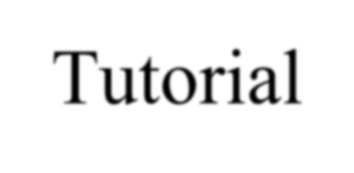
Nebraska Section, Rules and
Regulations
Tutorial

Slide 2
Rules and Regulations of the State of Nebraska for Wells and Pumps
Title 134-Regulations
Chapter 1- Definitions
Chapter 2- License Requirements, CEU’s, Exams
Chapter 3- Fees
Chapter 4- Construction Standards
Chapter 5-Licensing Board

Slide 3
Practice Act-State Statute
Water Well Standards and Contractor’s Licensing Act
Sections 46-1201 / 46-1241
Matrix of Title 134 regulations
Features 4 distinct purposes-46-1202

Slide 4
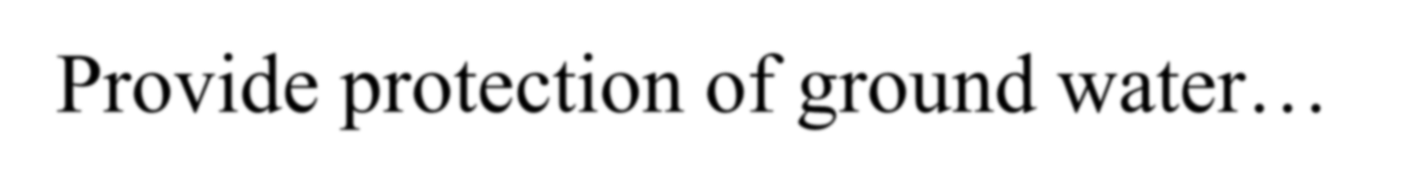

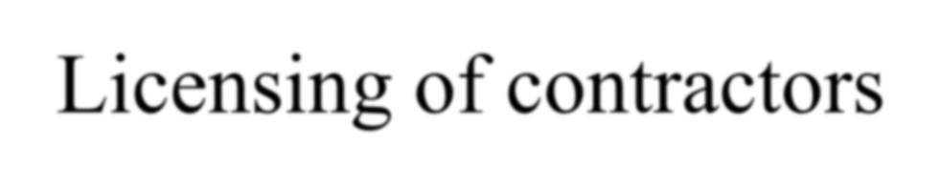
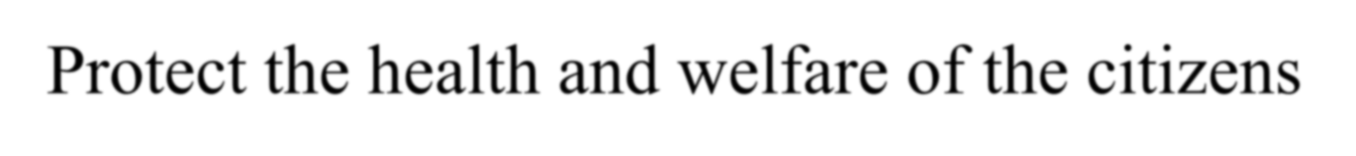

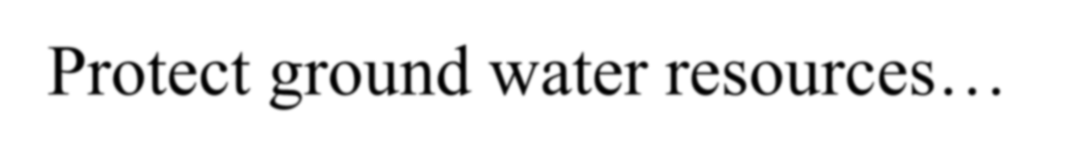
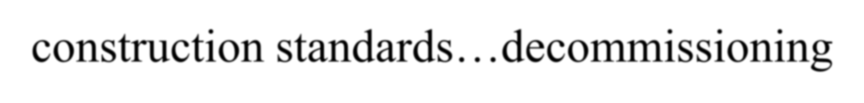
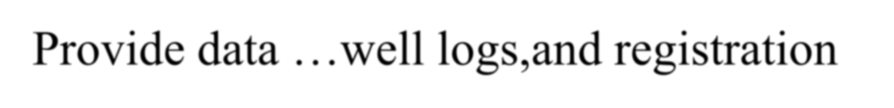
46-1202, Purpose of the Act
Provide protection of ground water…
Licensing of contractors
Protect the health and welfare of the citizens
of the State
Protect ground water resources… construction standards…decommissioning
Provide data …well logs, and registration

Slide 5
Title 134 – Chapter 1and 2
Scope of Authority
Definitions,
Continuing Education Program,
Provider,
Certificate or proof of attendance.

Slide 6
Title 134
Business engaged… Water Wells… Pumps and
Pumping Equipment.
Licensed Water Well/Pump installation, Contractor- Telecommunication required. Licensed Supervisor, Water Well Monitoring Technician- know the limitations.
Person.

Slide 7
When a License is required
“A water well must be constructed, pumps and pumping equipment must be installed and repaired onsite and water wells decommissioned in accordance with Title 134 Chapter 4 ”
“… a water well may only be opened or the seal broken by;
“a licensed contractor or supervisor…
Landowner, farm ranching, place of abode…
Licensed water well monitoring technician, natural resources
Licensed public water supply systems operator…
State electrical inspector.”

Slide 8
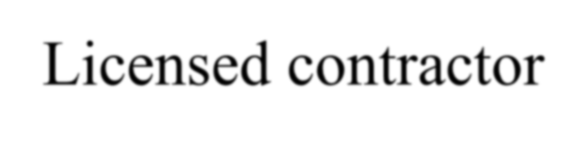

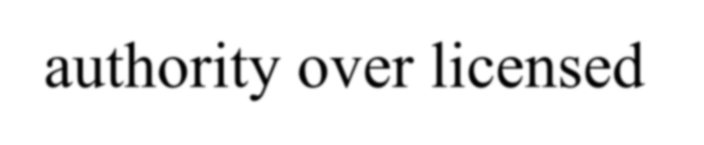

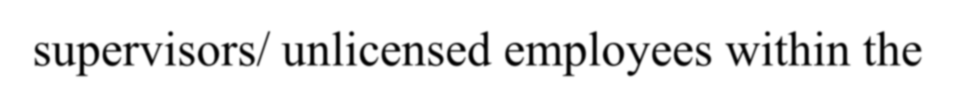
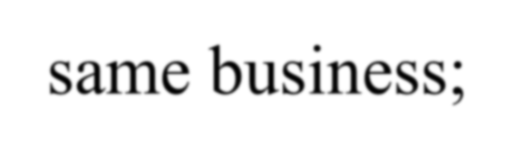
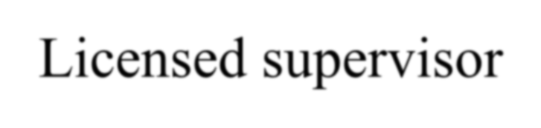
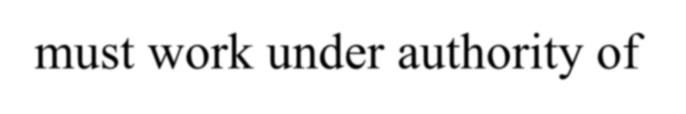
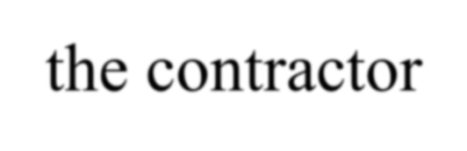
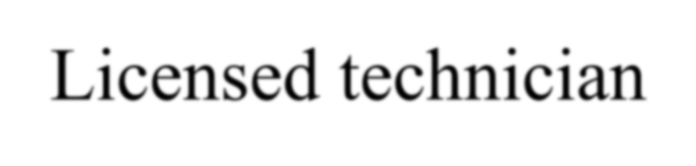
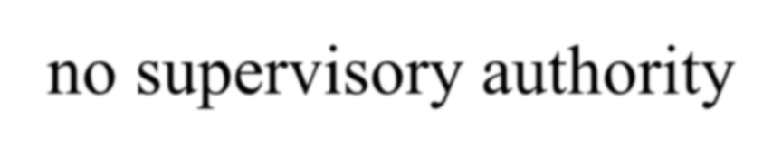
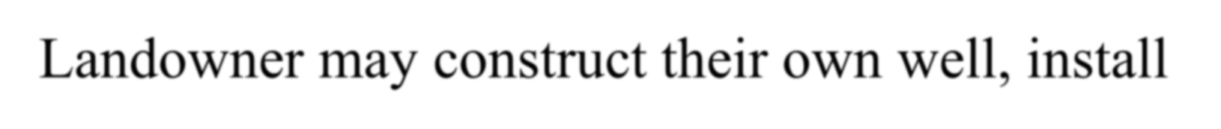
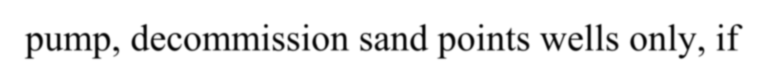
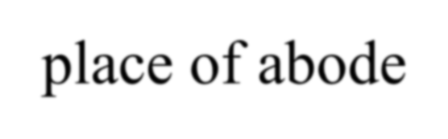
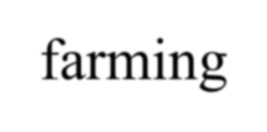
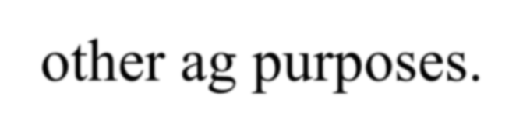
Authority
Licensed contractor- authority over licensed supervisors/ unlicensed employees within the same business;
Licensed supervisor- must work under authority of
the contractor
Licensed technician- no supervisory authority
Landowner may construct their own well, install pump, decommission sand points wells only, if place of abode- farming-other ag purposes.

Slide 9
License Qualifications
Age of Majority-19
Completed Application
Pay the fees
Pass the exam(s)- 70%
Proof of insurance -Contractors license only
Comply with the Act

Slide 10
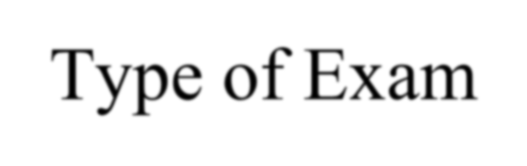

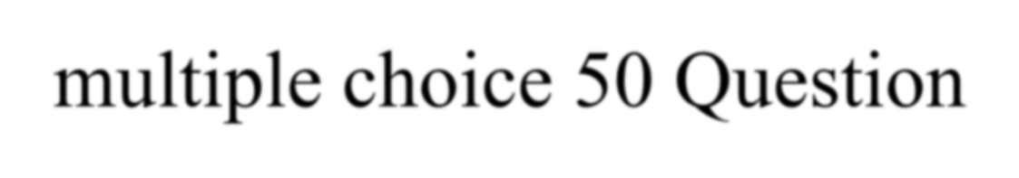
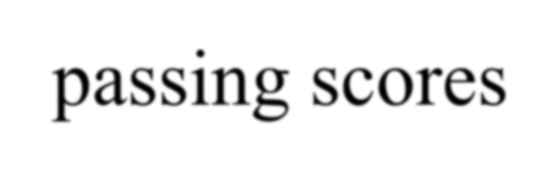
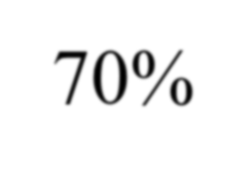
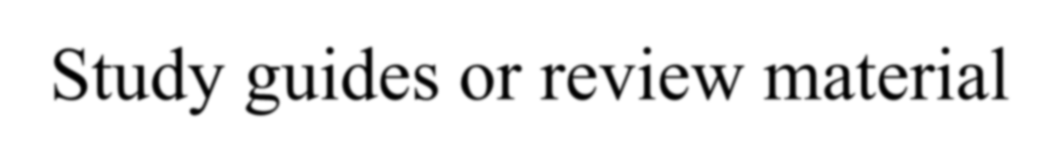
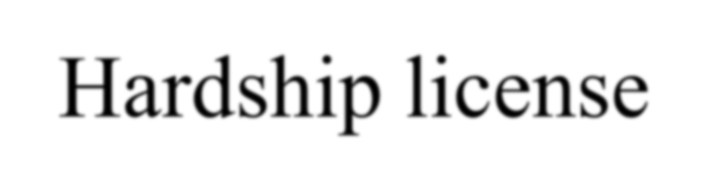
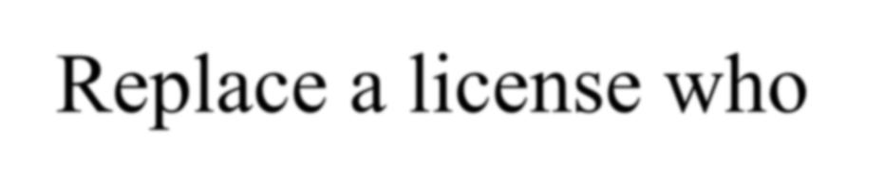
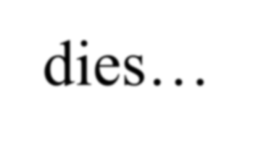
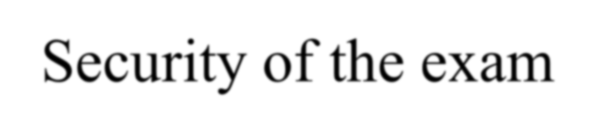

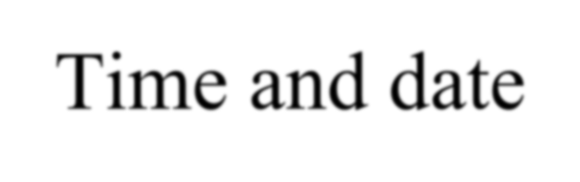
Licensure-Exams
Type of Exam- multiple choice 50 Question
passing scores- 70%
Study guides or review material
Hardship license- Replace a license who
dies…
Security of the exam
Procedures
Time and date

Slide 11
CEU requirements
12 hours of CEU’s on or before Dec 31 of the full second year.
certifying attendance to any CEU program on or before Dec 31 of the renewal period
Maintain a record of classes attended
Verify with the board approval of classes for CEU’s
Maintain Documentation of attendance

Slide 12
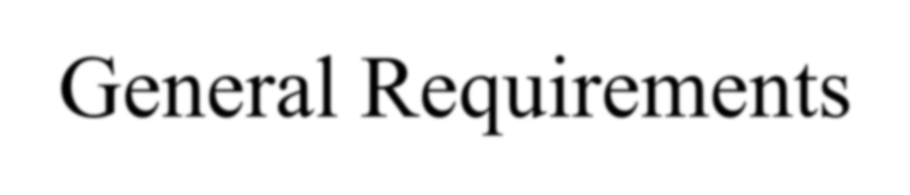

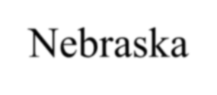


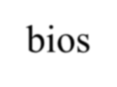
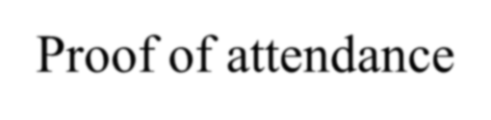
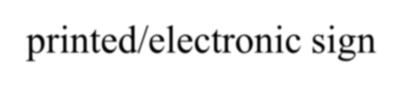

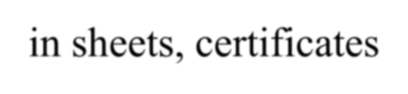
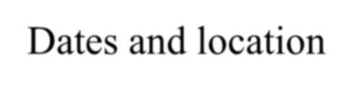
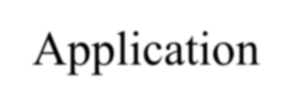

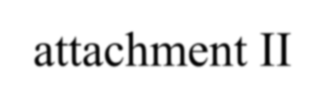
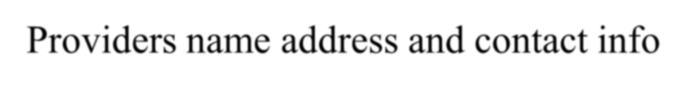
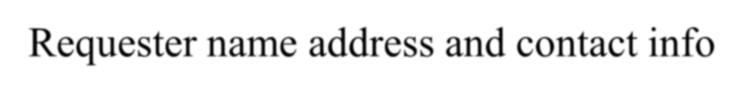
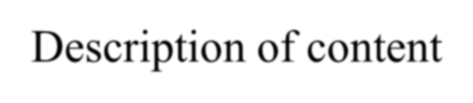
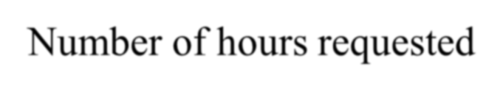
Board CEU Approval
General Requirements
  Must relate to groundwater industry, regulatory subject specific to
Nebraska
  Qualified presenters-bios
  Proof of attendance- printed/electronic sign –in sheets, certificates
  Dates and location
Application- attachment II
  Providers name address and contact info
  Requester name address and contact info
  Description of content
  Number of hours requested

Slide 13
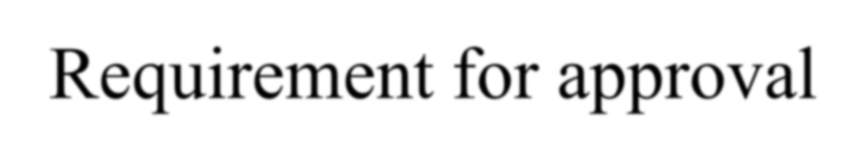
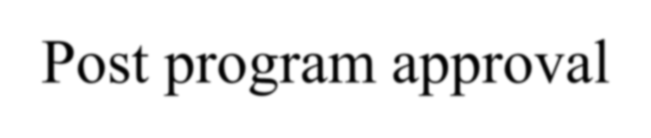
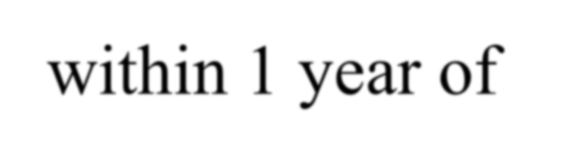
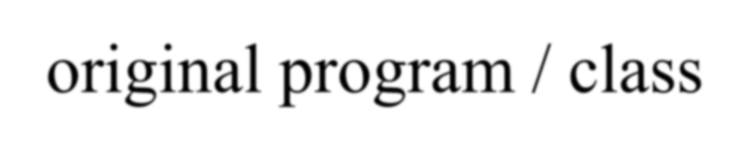
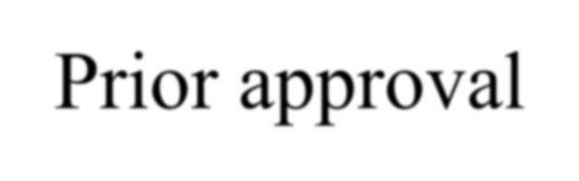
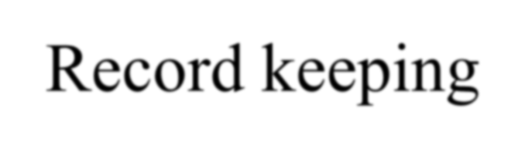


CEU Program Approval
Requirement for approval
Post program approval-within 1 year of original program / class
Prior approval
Record keeping
Exemptions from CEU- board approval

Slide 14
License Renewal
Expiration date- Dec 31 each even year
Proper fees are paid
Late renewal, date , fee- $200.00
CEU’s requirement - 12 hours in two years
Over 60 days expired requires a new Application and must meet the same requirements as initial licensing including passing examinations.

Slide 15
DISCIPLINARY ACTION
Department may deny, refuse renewal, suspend, limit, or revoke for the following offense….
Violation of the act or standards… Failure to report unregistered wells 46-604
Procedure if denied, refused renewal, suspends or revoked

Slide 16
PENALTIES
Censure- least severe
Probation
Limit the scope of license
Civil penalty ( fine )
Suspension
Revocation, or Dismissal- most severe

Slide 17






Hearings
 Right to a hearing - using evidence
Failure to appear after hearing request
Appeal of order/ judgement
Cost of proceedings- ( loser pays )

Slide 18
Other Sanctions
Class II , Class III misdemeanor
Licensed contractor penalty- Criminal
$500.00 and Class III misdemeanor / Civil
$500.00 per day
Unlicensed contractor penalty- Criminal
$1000.00 and Class II misdemeanor / Civil
$1000.00 per day

Slide 19
Late Renewal of License
Eligibility of expired license
Late renewal within 60 days of expiration-Late renewal Application –late fee assessed
Late renewal after 60-day expiration- retake all exams-Late renewal application-late fees applied
After Disciplinary Action- hearing

Slide 20









Licensing Summary
Who needs a license- Landowner?
Professional?
How to get a license
What kind of license to get
How to renew a license
How to lose a license
How to get a license back-reinstatement

Slide 21









Summary
Continuing Education
Program-program provider- required hours
CEU approval
Fee’s
Licenses
Late renewal

Slide 22









Fees
Board sets fees for:
Licenses
Well registrations
Late renewal fees- $200.00
Declaratory Orders-$100.00
Variances -$100.00

Slide 23











Title 134-Chapter 5
Board members - Term of service
5 year terms
Make up of the board- Governor Appointee
10 members- 6 industry, 4 governmental
Duties and functions;
Approve CEU’s… develop regulations… exams.

