Slide 1
Integrated Water Management in Nebraska:
Successes and Challenges
Jennifer J. Schellpeper
Water Planning Division Manager
Nebraska Department of Natural Resources
Notes:
Good morning!
Thanks for that great introduction. As stated I'm Jennifer Schellpeper, with the Nebraska Department of Natural Resources. Our agency manages surface water in the State of Nebraska.
We also jointly manage surface water along with our 23 local Natural Resource Districts, which manage groundwater. And this will be the focus of my presentation today – Joint Integrated Water Management in the State of Nebraska.
I will review some of the key tools in Nebraska’s legislative toolbox that make it successful as well as discuss some challenges that we've seen along the way.

Slide 2
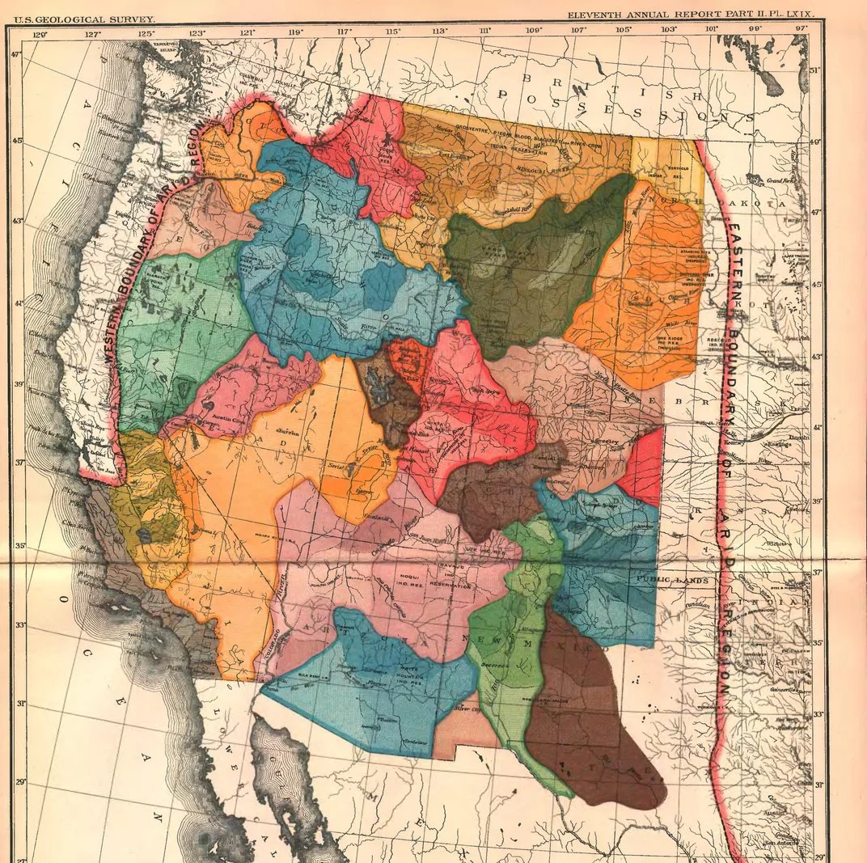
Arid Region of the United States presented to the U.S. Senate
John Wesley Powell offered a vision of the American West centered on watersheds rather than on traditional political boundaries
Powell understood that along a mountain ridgeline two drops of rain hitting the ground only inches apart along the Continental Divide, could travel far different directions. One reaching the Pacific, while the other the Atlantic or Arctic oceans.
Powell proposed that Americans listen to what the land itself and the climate would tell them.
https://www.smithsonianmag.com/smithsonian-institution/visionary-john-wesley-powell-had-plan-developing-west-nobody-listened-180969182/
From THE PROMISE OF THE GRAND CANYON by John F. Ross, published by Viking, an imprint of Penguin Publishing Group, a division of Penguin Random House, LLC. Copyright © 2018 by John F. Ross.
Notes:
The tools in Nebraska's toolbox for managing integrated surface and groundwater come from what we've learned from history.
John Wesley Powell recognized in the late 1800s that in the Arid Western United States, it was important to draw political boundaries based upon watershed boundaries.

Slide 3

Governing the Commons
Can a group of people organize and govern themselves to obtain continuing joint benefits from a resource when all face temptations to free-ride, shirk, or otherwise act opportunistically, and overuse the resource?
Studies of over 1000 cases worldwide
Laboratory Studies
Game Theory
Notes:
Further, research by doctor Elinor Ostrom described in her book “Governing the Commons” showed that there are several key principles for managing a common pool resource, such as groundwater and surface water rights.
Nebraska's 20-year record of successful integrated water management is built upon the ideas of both of these great thinkers.

Slide 4
Nebraska Integrated Management
Keys to Success – Legislative Toolbox
Elinor Ostrom’s
Nebraska Water Planning
Principles for Managing a Commons
Clear boundaries
Rules match local needs and conditions
Affected users participate in rule making
Local rules respected by outside authorities
Member system to monitor
Graduated sanctions for violators
Accessible dispute resolution
Nested tiers of governing responsibility
Effective communication & trust
Clear boundaries (1)
Decentralized water management (2,4)
  Local control
Stakeholders (2,3)
Monitoring (5,6)
Dispute resolution process (7)
Nested tiers (8)
Trust and communication (9)
Notes:
Our toolbox actually ticks off each of the elements from Dr. Ostrom’s research as you can see matched up here.
I'm not going to have time to touch on all of these today so we're just going to hit on a few highlights.

Slide 5
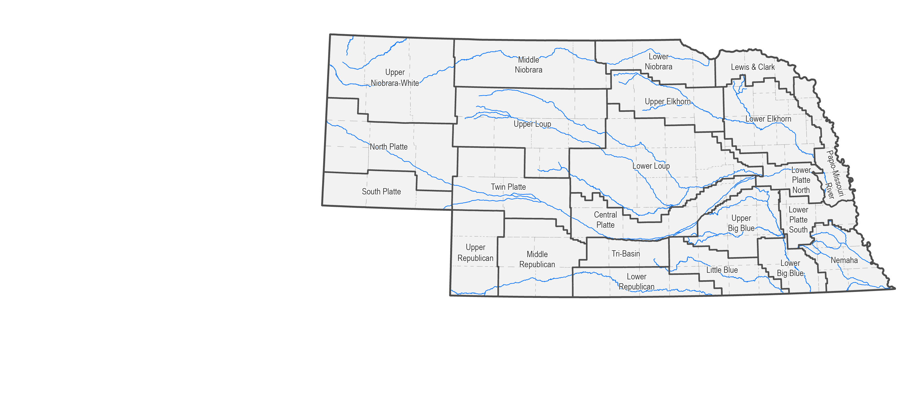
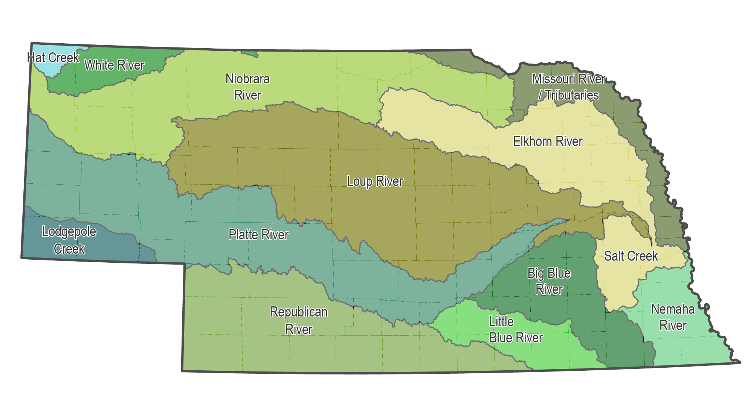
Nebraska Integrated Management
Keys to Success – Boundaries (1)
a map clearly delineating the geographic area subject to the integrated management plan
Notes:
The first principle is having well-defined boundaries. A feature that I believe makes Nebraska unique is that our politically defined natural resource boundaries follow the advice from John Wesley Powell, to follow the natural watersheds, for both Surface Water and Groundwater Management, as delineated on these maps.
The decision to manage groundwater along watershed boundaries was made in 1972, so we have had 50 successful years of managing our resources based on watershed boundaries.
Another unique aspect of the Natural Resource Districts is the local & decentralized control that allows for water user engagement, management, rule-making, and monitoring at a smaller scale.

Slide 6
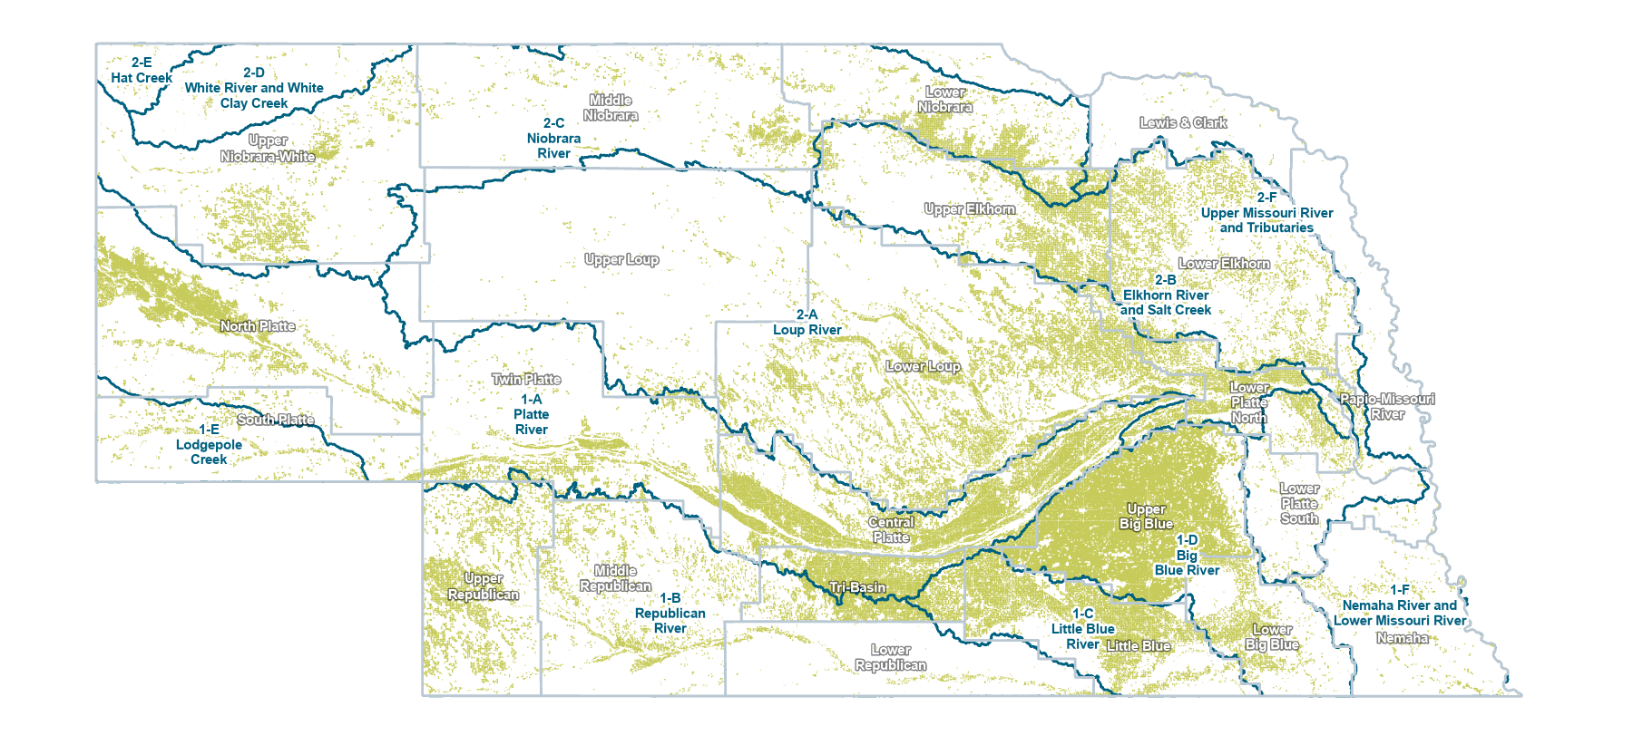
Nebraska Integrated Management
Keys to Success – Boundaries, Resource Area (1)
Notes:
The second component of boundaries is having a good inventory of the water rights – the legal uses of the water.
All of our surface water uses are permitted and the irrigation areas are digitized as are the majority of our groundwater rights, which are illustrated on this map.

Slide 7
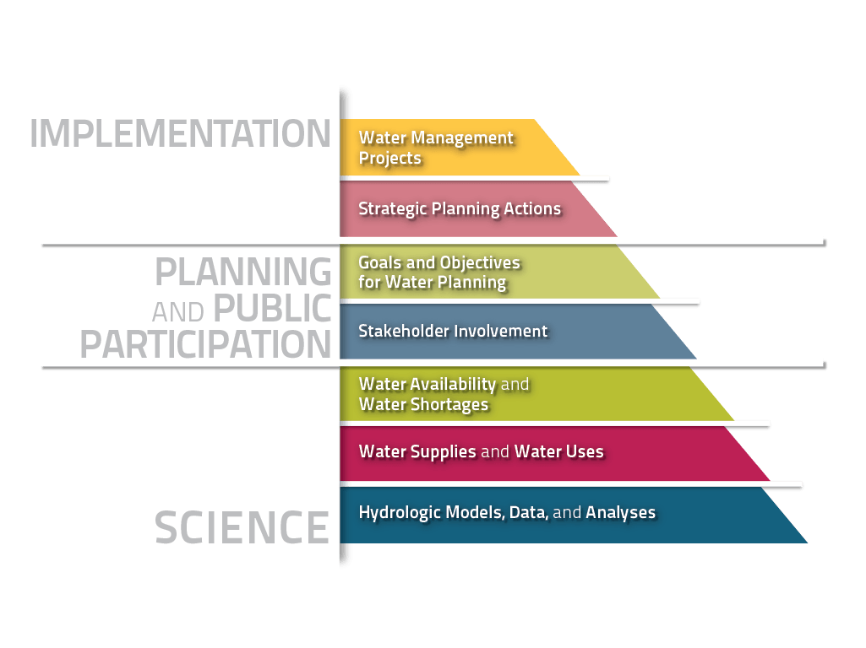
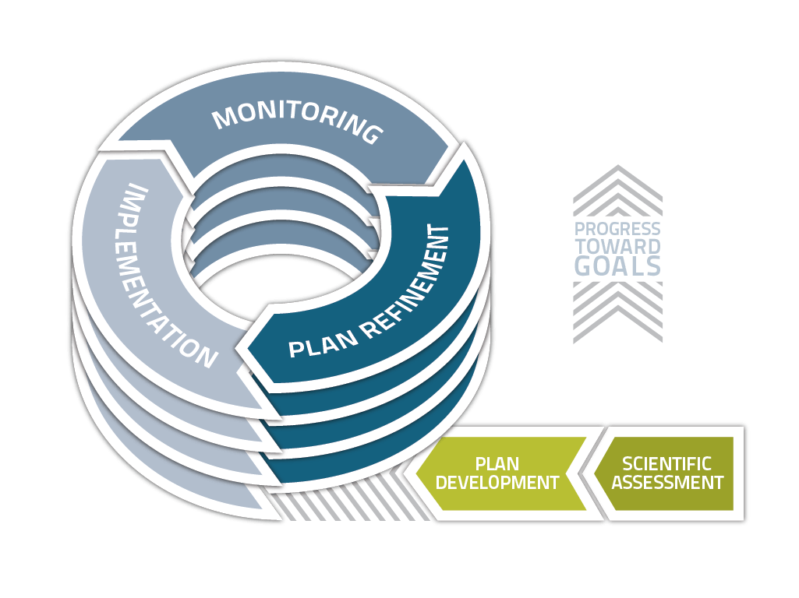
Nebraska Integrated Management
Keys to Success & Challenges – Science, Stakeholders, Process, Monitoring, Graduated Sanctions, (2,3,4,5,6), We can learn from our experiences and we have the flexibility to change.
Notes:
Another Key Principle is Monitoring. Nebraska Law calls for ongoing monitoring and evaluation of plan goals, objectives, and action items. We must measure our progress toward our goals.
To do so, we must have a foundation of Science and Data, so that we can make informed decisions. This is the foundational element of our Integrated Management pyramid. From there, we build the Goals and Objectives of our Plans.
We bring key stakeholders, to the table to work with policymakers, literally word-for-word, as we write the Plan Goals and Objectives. Stakeholders are not only “consulted with” under our state law, but are also called to participate as collaborators and to try and reach consensus on a Plan.
Therefore, the education of our stakeholders and policymakers is an important component of a successful plan. While education and stakeholder engagement make a plan successful, it is also a challenge.
Beyond basic data, we also have highly complicated groundwater and surface water model analyses that must be translated into information that is digestible and engaging. To do this well, resources such as skilled modelers, skilled communicators, and those who can link the 2 are needed.
All of this takes time, up to 5 years for each plan, and a commitment to hire the right people.

Slide 8
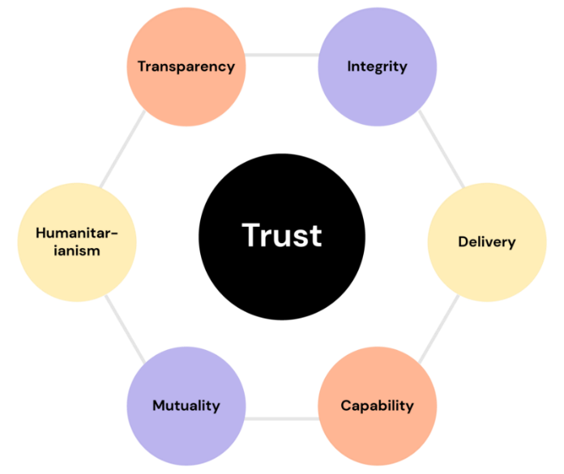
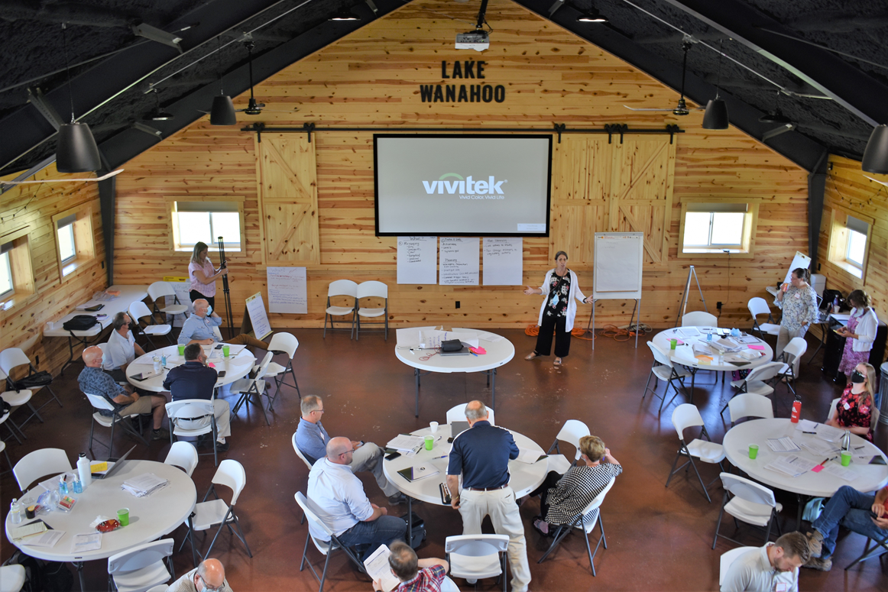
Nebraska Integrated Management
Keys to Success & Challenges – Stakeholders, Communication, & Trust Building
Basis of all social institutions - only when there is trust can governance work well over time
Notes:
To successfully engage with stakeholders you need to build trust. You need to have leaders who engage with the local managers, local water users, and local champions, the coffee shop talkers who will go out and talk with others in the community. That engagement builds trust and maintains relationships. Finding the right people, the passionate people, to do this work is a challenge.
I’ll share with you 2 of my success stories. In one basin, things were quite tense with many of the surface water users feeling they were being treated unfairly. And there were continual letters written to the Governor asking what the state was doing to improve things in the basin. Many of these stakeholders were around the table during the development of a basin-wide plan. Following that plan development process, those letters to the governor stopped. The accusatory letters to our Agency stopped. Some stakeholders did continued to correspond with me, with our agency, to share new data and information they thought could be helpful as the plan was implemented. We were able to build trust with those folks.
A second example is from one of the more strained basins in Nebraska, where we've had 2 rounds of integrated management planning. The first round took the full 5 years to complete, down to the last possible day to meet the 5-year deadline in statute and we did not get a consensus from all the people at the table. The second round all of the same stakeholders from the first time around were invited to participate again. At one meeting I was speaking about calculations of stream flow depletion and groundwater pumping, and a stakeholder who was there the first time corrected me. He said “now just a minute there, don’t you mean consumptive use? We went round and round the first time we did this and it took a long time to get a group understanding that it’s the consumptive use that counts, not the amount pumped”. I was astounded and elated. Here was a stakeholder who had learned and remembered and who kept me in line.
This was one of my most rewarding moments in integrated water management in Nebraska.

Slide 9
Thank You & Questions
Summary
Successful Water Management Takes Commitment to Building Trust at the Local Level
Jennifer J. Schellpeper
Water Planning Division Manager
(402) 471-2899
jennifer.schellpeper@nebraska.gov
Notes:
To Summarize
Nebraska’s Water Law is built on proven philosophies from our past.
Based on my experience, a critical component of that philosophy is a commitment to building and maintaining trust at the local level –
this is where you will find your success stories.

